Slide 1
VCF Operations Overview

Slide 2
Importance
VMware Cloud Foundation (VCF) Operations encompasses the day-to-day management, monitoring, and life cycle tasks required to maintain a healthy and efficient private cloud infrastructure. Through AI-powered management capabilities and deep integrations into your existing VMware product suite, VCF Operations provides streamlined control over compute, storage, networking, and management services across the entire fleet.
You must understand the capabilities and use cases VCF Operations enables, which help IT teams to manage their entire infrastructure fleet with greater efficiency and reduced risk.

Slide 3
Module Lessons
Introduction to VCF
Introduction to VCF Operations
VCF Operations Architecture
VCF Operations Navigation

Slide 4
Introduction to VCF Operations

Slide 5
Learner Objectives
List the key features of VCF Operations
Outline VCF Operations use cases

Slide 6
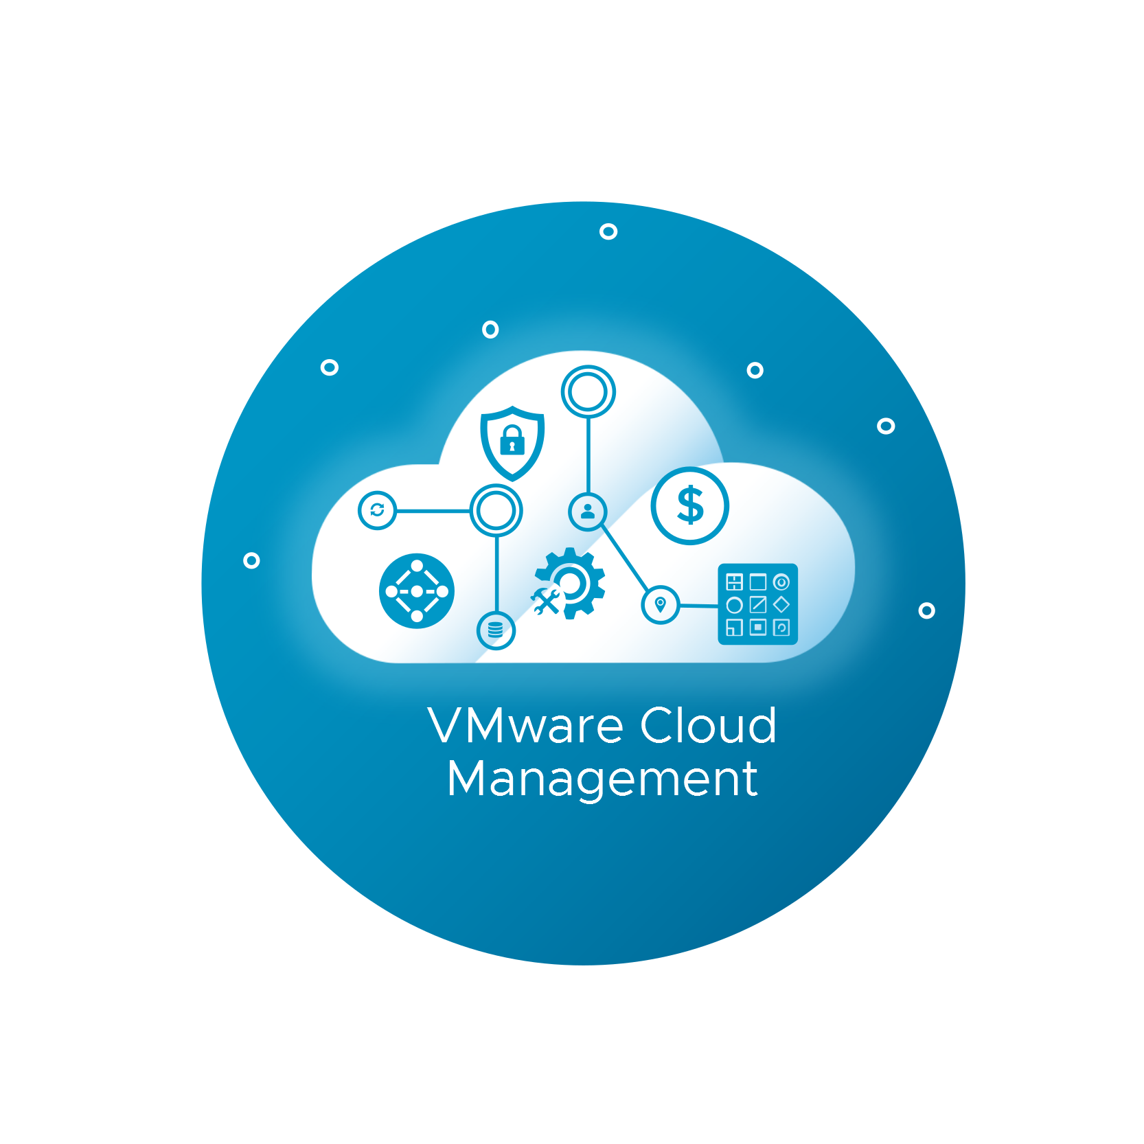
VCF Operations Overview
VCF Operations is the operations management platform that is a part of the VMware Cloud Foundation product suite.
VCF Operations delivers intelligent operations management with application-to-storage visibility across physical, virtual, and cloud infrastructures. It allows you to view and manage your entire fleet and all VCF deployments along with their associated management and workload domains in one place.
VCF Operations provides a more simplified and streamlined experience as organizations move to complex private, hybrid, and multi-cloud IT environments.
Notes:
TalkTrack:
VCF Operations is the operations management platform that is part of the VMware Cloud Foundation product suite. It delivers intelligent operations management with application-to-storage visibility across physical, virtual, and cloud infrastructures. This platform enables you to view and manage your entire fleet and all VCF deployments, along with their associated management and workload domains, from a single location. VCF Operations provides a more simplified and streamlined experience for organizations transitioning to complex private, hybrid, and multi-cloud IT environments. The concept of a VCF Fleet within VCF Operations encompasses a broad scope, including VCF Operations nodes such as primary, replica, data, and cloud proxy, as well as operations for logs, networks, automations, and more. It also includes the underlying platform components like SDDC Managers, vCenters, ESXi hosts, NSX instances, clusters, VMs, and datastores.
<End>
In VCF Operations, the concept of VCF Fleet has a broad scope that includes the VCF Operations nodes (primary, replica, data, cloud proxy, operations for logs, networks, automations, and etc.), and the platform (SDDC Managers, the vCenters, the ESXi hosts, the NSX instances, the clusters, the VMs, the datastores, and etc.).

Slide 7
VCF Operations Features
VCF Operations offers several key features:
Comprehensive monitoring and management capabilities to support your entire fleet
Predictive analytics for continuous operations management
Continuous performance optimization and intelligent remediation capabilities
Real-time, predictive capacity and cost analytics to proactively forecast demand and deliver actionable recommendations
Cost transparency across private, hybrid, and public clouds to optimize planning
Automation capabilities to support capacity planning, workload placement, and infrastructure optimization
Integrated compliance features to reduce risks and ensure regulatory standards compliance
Support for physical, virtual, and cloud infrastructure and container platforms
Notes:
TalkTrack:
VCF Operations offers several key features. These include comprehensive monitoring and management capabilities to support your entire fleet, along with predictive analytics for continuous operations management. It provides continuous performance optimization and intelligent remediation capabilities, as well as real-time, predictive capacity and cost analytics to proactively forecast demand and deliver actionable recommendations. VCF Operations also offers cost transparency across private, hybrid, and public clouds to optimize planning. It includes automation capabilities to support capacity planning, workload placement, and infrastructure optimization, and integrated compliance features to reduce risks and ensure regulatory standards compliance. Finally, it supports physical, virtual, and cloud infrastructure and container platforms.
<End>

Slide 8
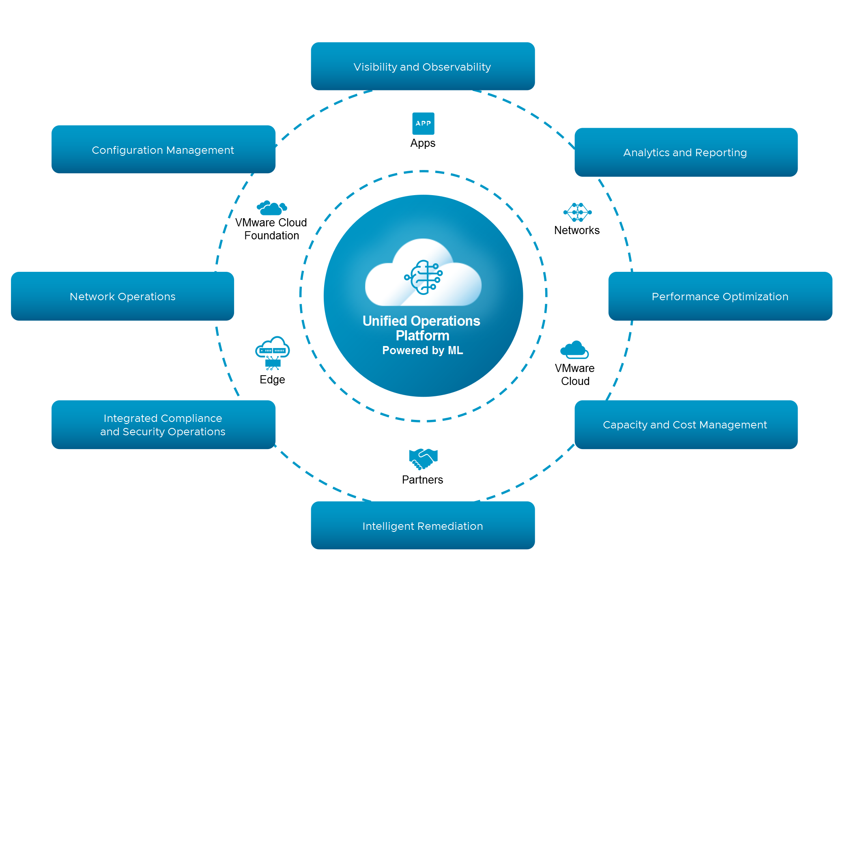
VCF Operations Use Cases
With 360-degree infrastructure management capabilities, VCF Operations helps organizations achieve mission-critical use cases:
Visibility and Observability
Analytics and Reporting
Performance and Optimization
Capacity and Cost Management
Intelligent Remediation
Integrated Compliance and Security Operations
Network Operations
Configuration Management
Notes:
TalkTrack:
With its 360-degree infrastructure management capabilities, VCF Operations can assist organizations in achieving various key use case domains. These include visibility and observability, analytics and reporting, and performance and optimization. Furthermore, it offers capacity and cost management, intelligent remediation, and integrated compliance and security operations. Finally, VCF Operations supports network operations and configuration management.
<End>

Slide 9
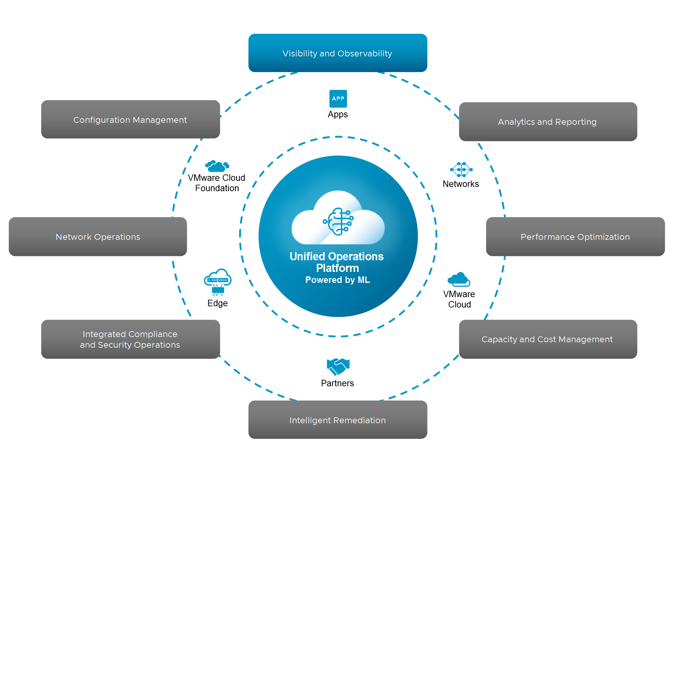
Visibility and Observability
VCF Operations integrates various infrastructure operations features to provide comprehensive visibility and observability into your entire fleet.
A wide range of data metrics are collected from infrastructure objects. These metrics are then used in visibility tools, such as Dashboards, Views, and Reports, to help organizations understand the status of their infrastructure.
VCF Operations can also help organizations to monitor their Kubernetes deployment and Tanzu workloads from the VCF Operations console.
Notes:
TalkTrack:
VCF Operations integrates various infrastructure operations features to provide comprehensive visibility and observability across your entire fleet. A wide range of data metrics are collected from infrastructure objects, which are then utilized in visibility tools such as Dashboards, Views, and Reports to help organizations understand the status of their infrastructure. Additionally, VCF Operations can assist organizations in monitoring their Kubernetes deployment and Tanzu workloads directly from the VCF Operations console.
<End>

Slide 10
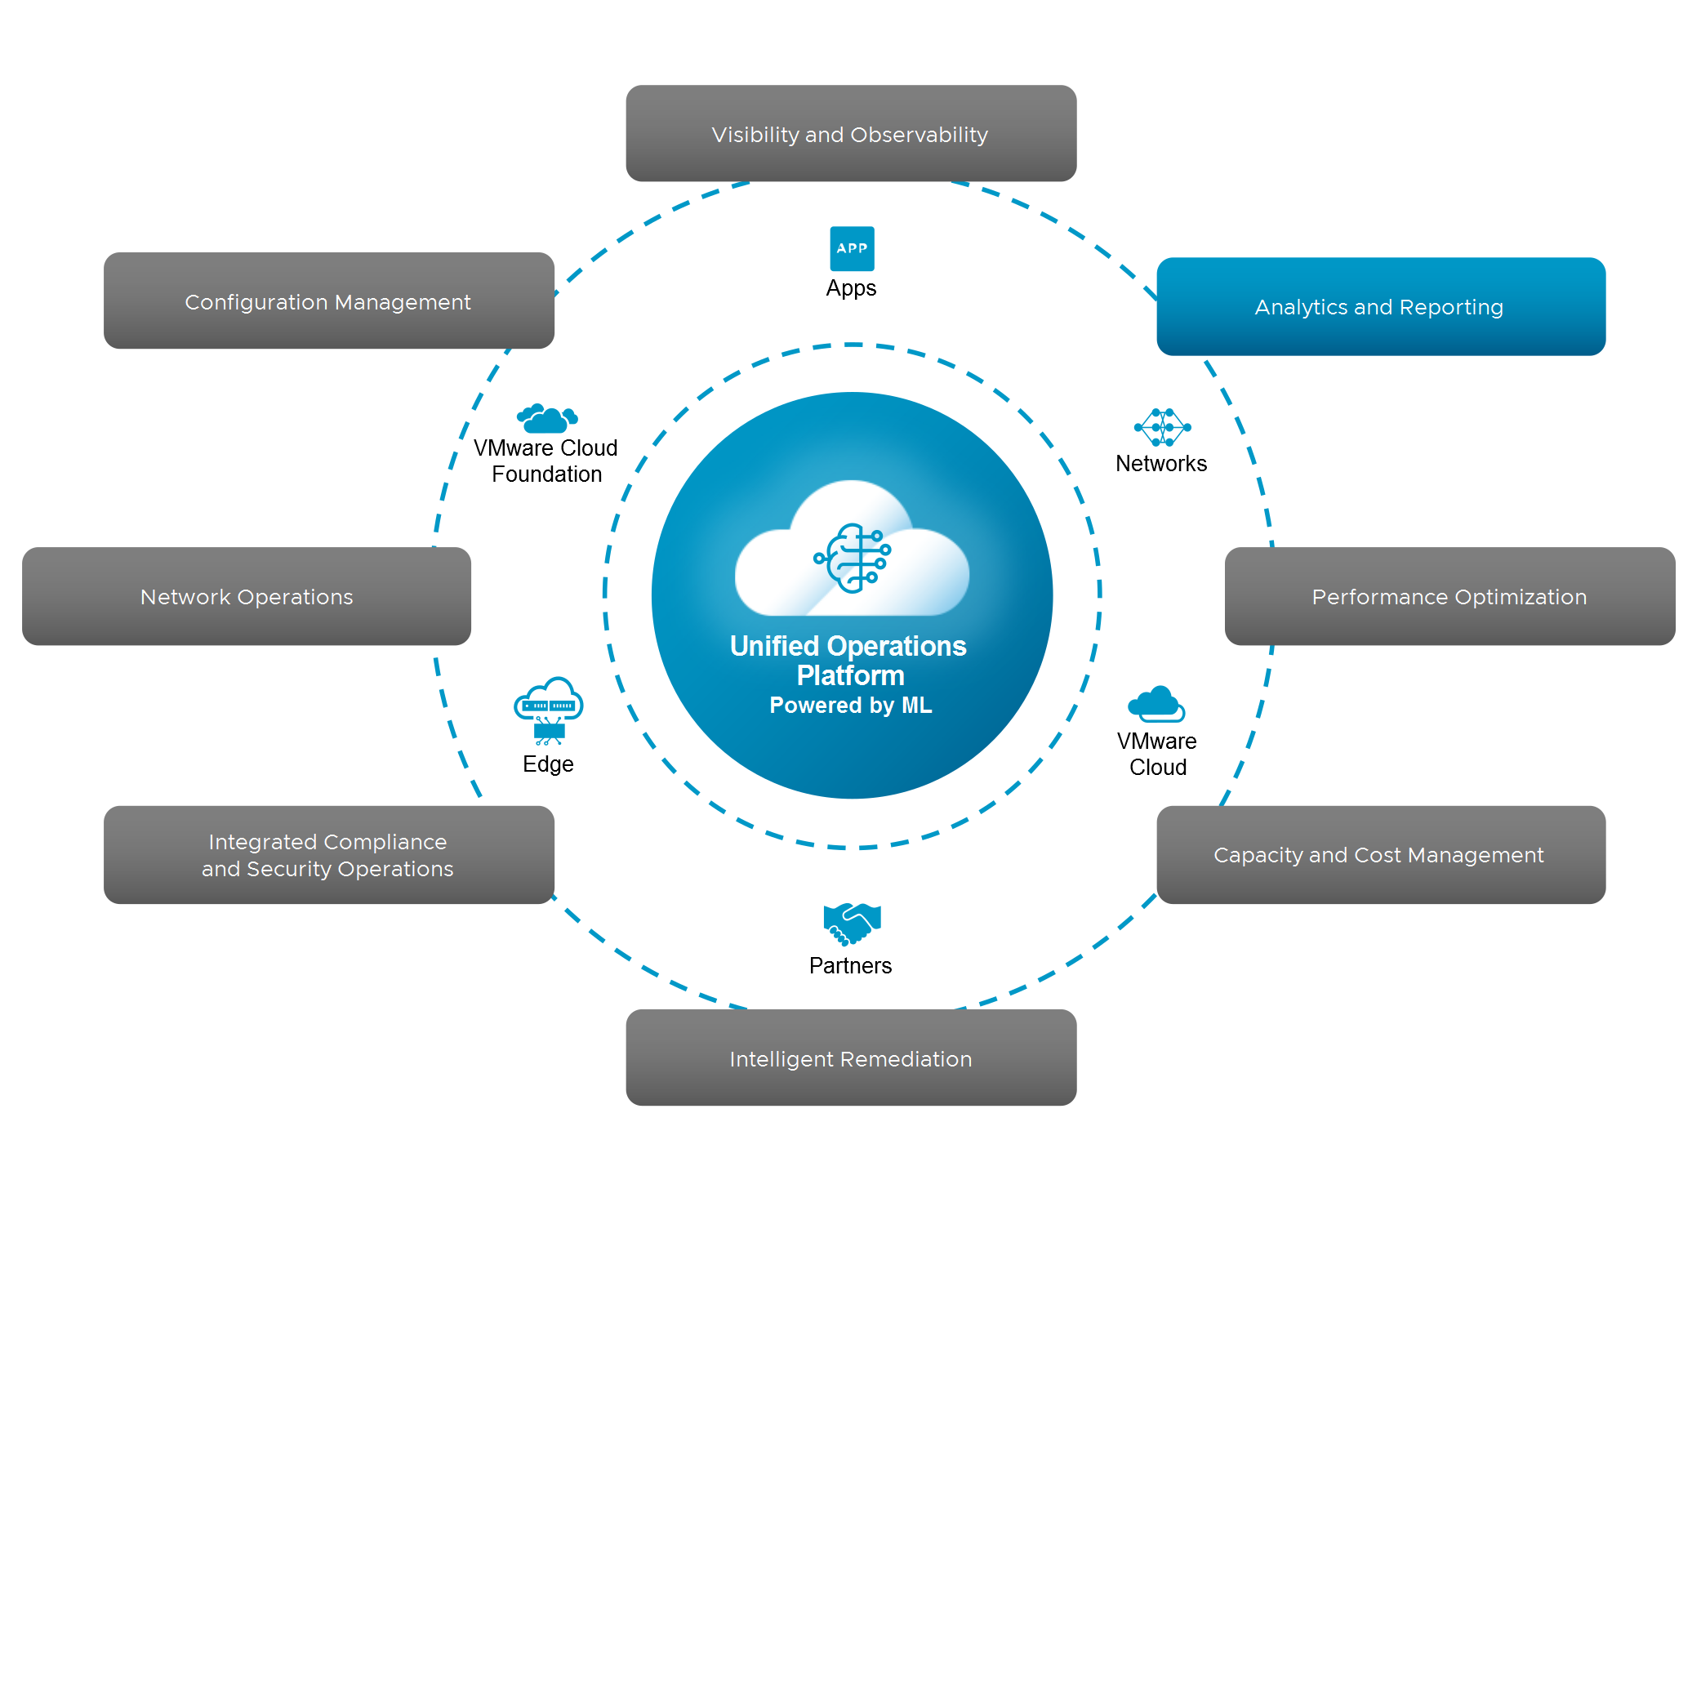
Analytics and Reporting
With the data and metrics collected from an organization's IT infrastructure, administrators can use the Alerts, Troubleshooting Workbench, and Log Analysis capabilities to remediate issues when they arise.
Troubleshooting Workbench enables you to perform advanced troubleshooting tasks on the alerts triggered on objects from your fleet. You can investigate both known and unknown issues in VCF Operations.
Notes:
TalkTrack:
With the data and metrics collected from an organization's IT infrastructure, administrators can leverage the Alerts, Troubleshooting Workbench, and Log Analysis capabilities within VCF Operations to remediate issues as they arise. Specifically, the Troubleshooting Workbench enables advanced troubleshooting tasks on alerts triggered by objects in your fleet, allowing investigation of both known and unknown issues within VCF Operations.
<End>

Slide 11
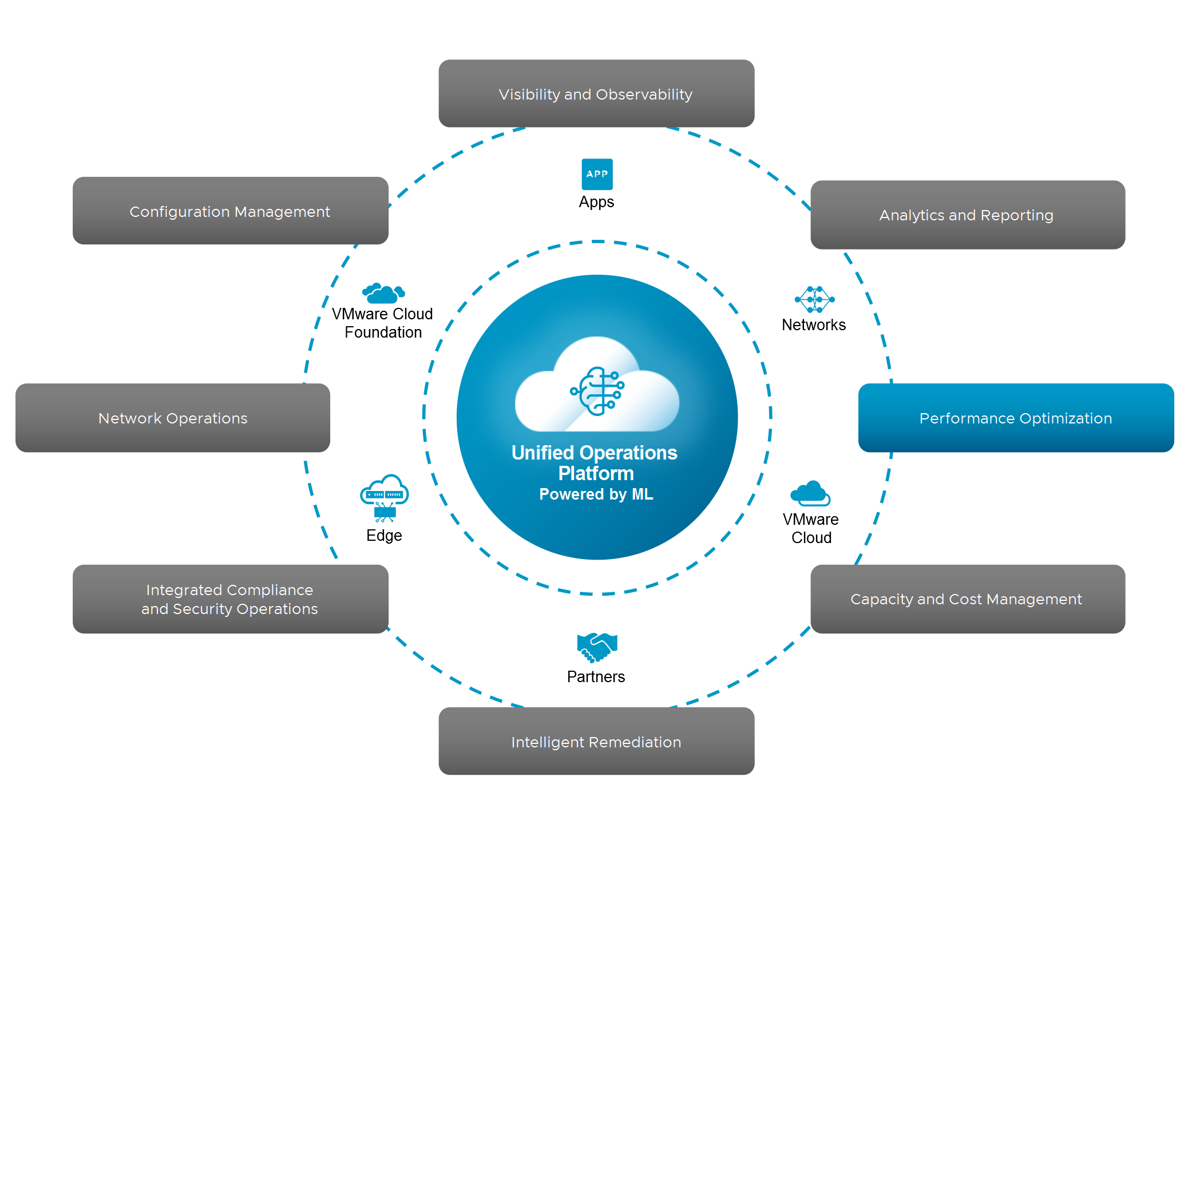
Performance and Optimization
Organizations can use VCF Operations to ensure optimal performance across private cloud environments by leveraging real-time predictive analytics and Artificial Intelligence (AI)-driven insights.
By automatically balancing workloads and avoiding contention, organizations can continuously optimize hyperconverged infrastructure (HCI) and software-defined data center (SDDC) to meet operational and business objectives.
Notes:
TalkTrack:
A focus on performance and optimization within private cloud environments is crucial. Real time predictive analytics and artificial intelligence driven insights enable this continuous optimization. The system ensures hyperconverged infrastructure (HCI) and software defined data center (SDDC) align with both operational and business objectives. It automates workload balancing, thereby preventing resource contention. This leads to consistent and efficient resource utilization.
<End>

Slide 12
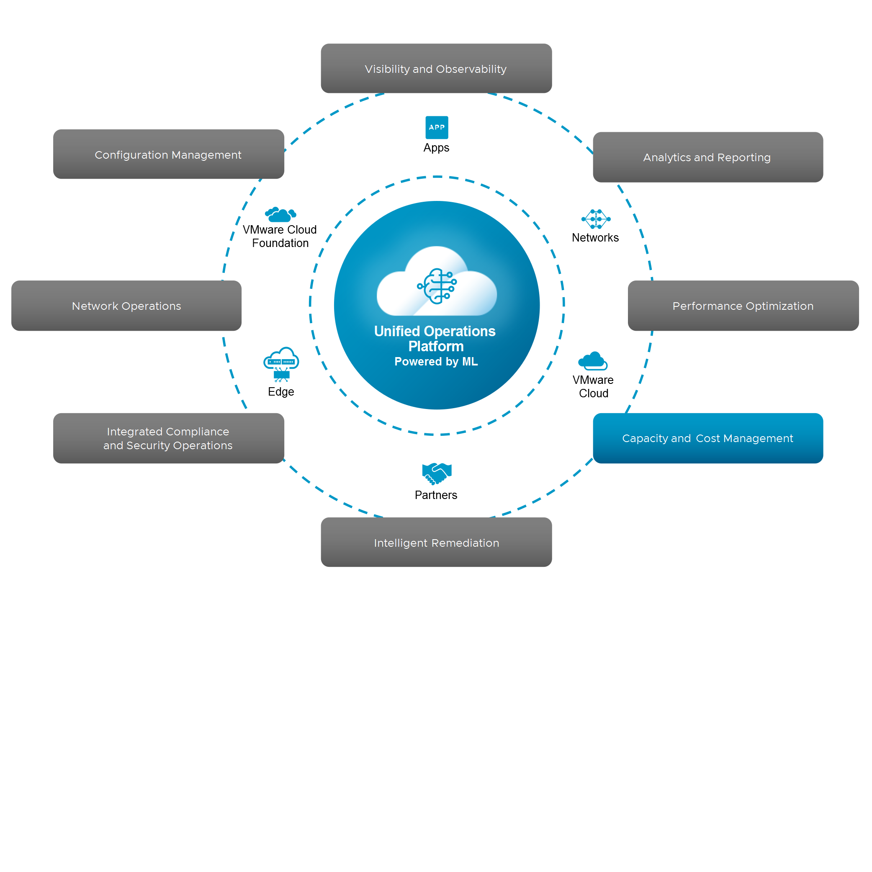
Capacity and Cost Management
Organizations can reduce costs and improve efficiency through real-time, predictive capacity and cost analytics. By leveraging machine learning and AI, it accurately forecasts future demand, provides actionable recommendations, and automates resource reclamation and rightsizing, optimizing utilization and minimizing expenses across VMware Cloud Foundation.
Notes:
TalkTrack:
Organizations can reduce costs and improve efficiency by leveraging real time, predictive capacity and cost analytics. Machine learning and artificial intelligence are key to accurately forecasting future demand, providing actionable recommendations, and automating resource reclamation and rightsizing. This process optimizes utilization and minimizes expenses across VMware Cloud Foundation environments.
<End>

Slide 13

Intelligent Remediation
VCF Operations enables proactive troubleshooting and remediation by correlating metrics, events, logs, troubleshooting workbench, and configuration data to detect anomalies across your private cloud.
By providing actionable insights, VCF Operations accelerates problem resolution, enhances visibility, and centralizes IT operations management, ensuring smooth and uninterrupted operations.
Notes:
TalkTrack:
VCF Operations enables proactive troubleshooting and remediation. It achieves this by correlating metrics, events, logs, information from the troubleshooting workbench, and configuration data to detect anomalies across the private cloud. Providing actionable insights accelerates problem resolution and enhances visibility. The system centralizes IT operations management, ensuring smooth and uninterrupted operations.
<End>

Slide 14
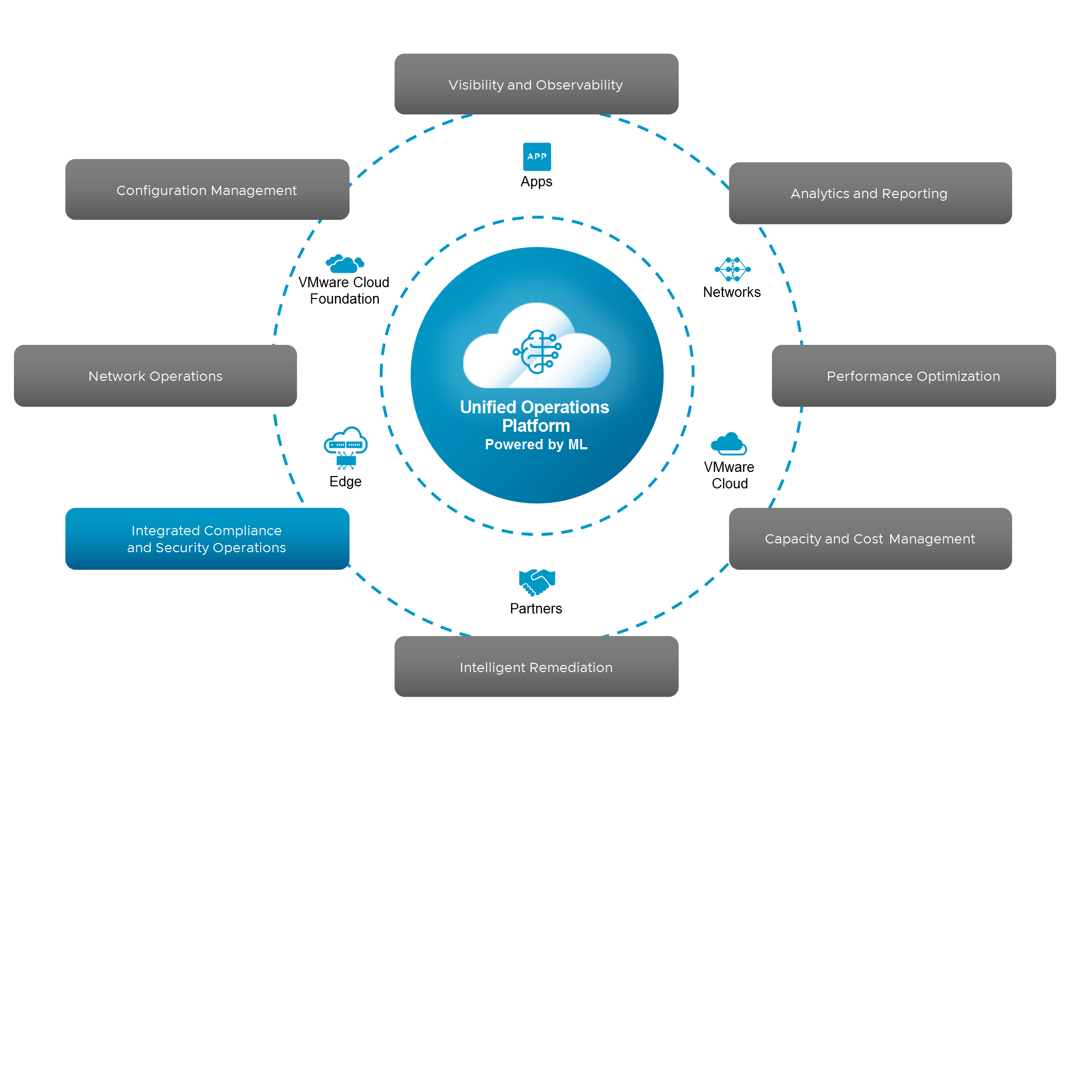
Integrated Compliance and Security Operations
Organizations can also mitigate risks and ensure regulatory compliance with compliance features integrated with VCF Operations.
By automating drift remediation and enforcing IT regulatory standards (PCI, HIPAA, or custom standards), VCF Operations helps organizations reduce the likelihood of security breaches and compliance violations.
Notes:
TalkTrack:
Organizations can mitigate risks and ensure regulatory compliance through VCF Operations integrated compliance features. Automating drift remediation and enforcing IT regulatory standards, such as PCI, HIPAA, or custom standards, reduces the likelihood of security breaches and compliance violations.
<End>

Slide 15
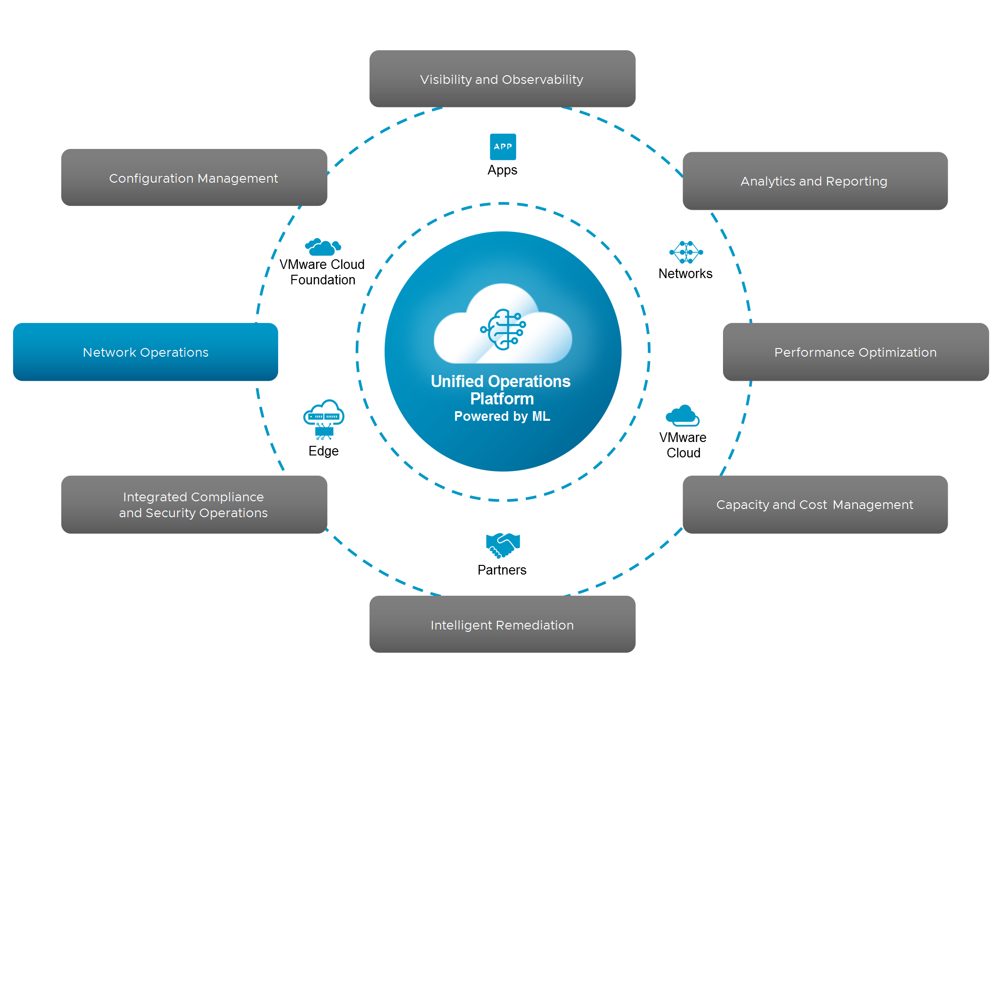
Network Operations
VCF Operations provides simple end-to-end Network Operations capabilities to troubleshoot and get best practices for their VCF network deployments. Administrators can use VCF Operations to gain visibility into both physical and virtual infrastructure with a comprehensive flow assessment.
Organizations can also simplify NSX operations management with an intuitive UI and natural language search to quickly pinpoint network issues and troubleshoot, as well as get best practices deployment and compliance recommendations.
Notes:
TalkTrack:
VCF Operations provides end to end Network Operations capabilities for VCF network deployments. This includes best practices for troubleshooting. Administrators gain visibility into both physical and virtual infrastructure through comprehensive flow assessment. NSX operations management simplifies through an intuitive user interface and natural language search. This allows for quick identification of network issues, troubleshooting, and provides deployment and compliance recommendations.
<End>

Slide 16
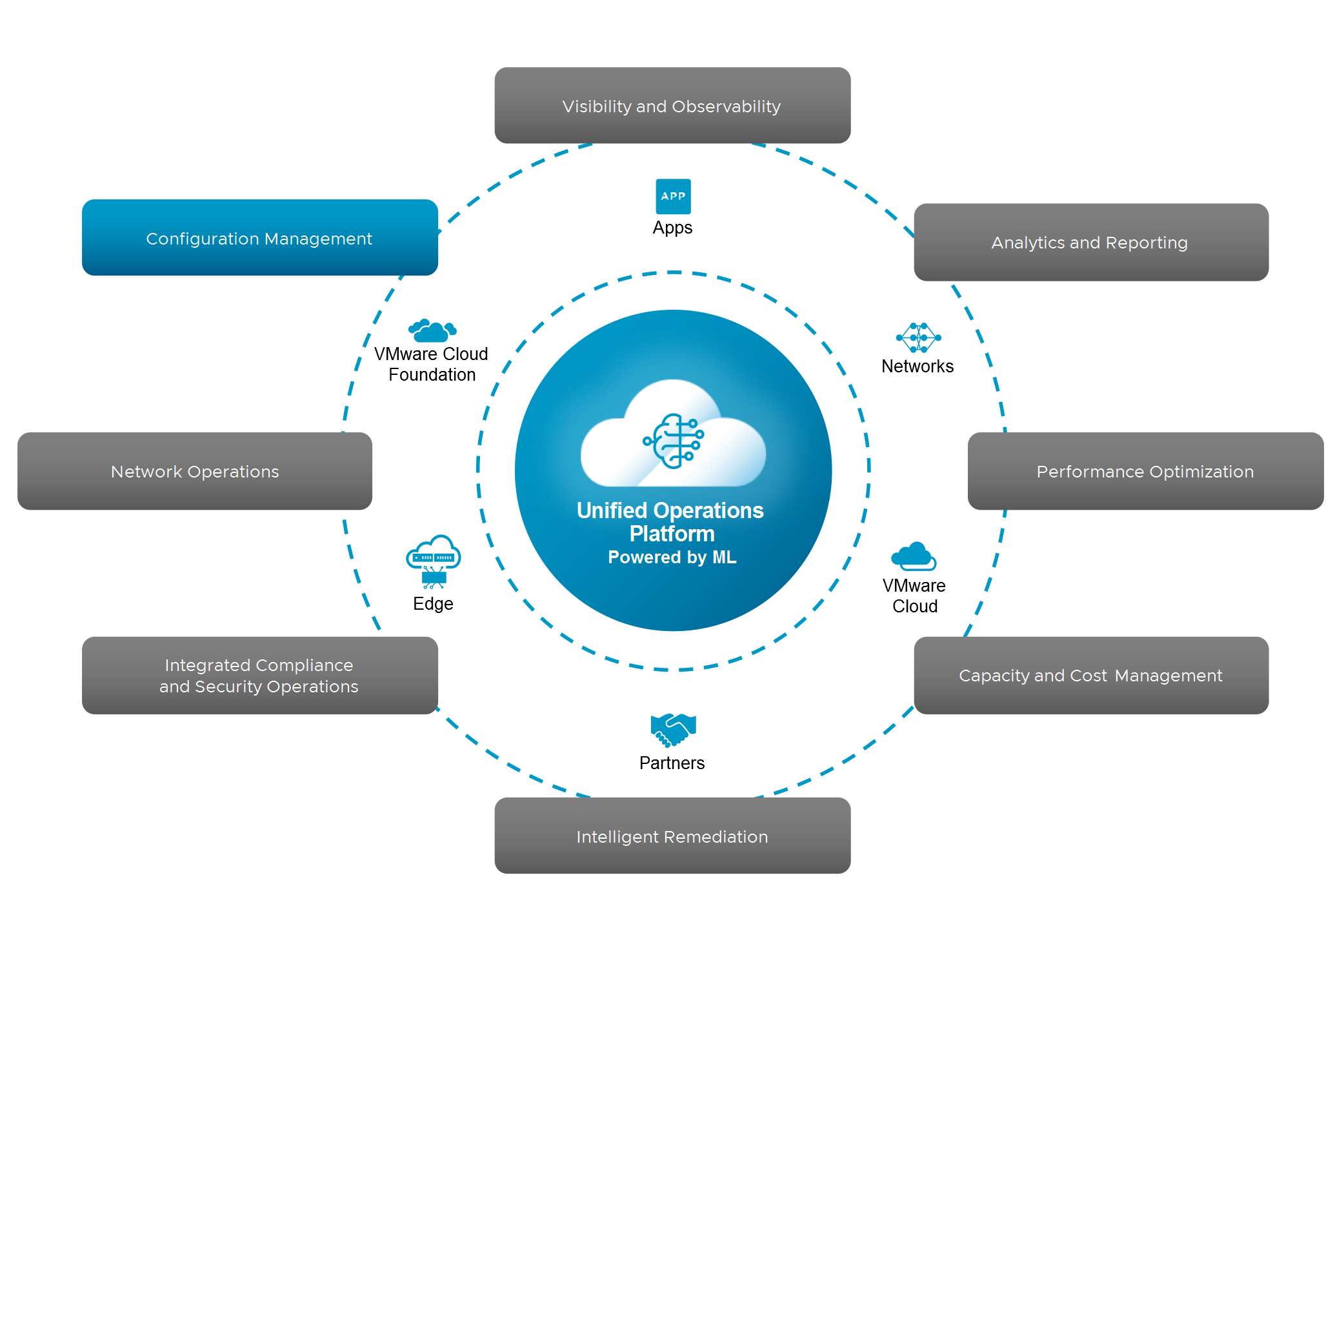
Configuration Management
VCF Operations provides Configuration Drift detection capability, enabling Admins to monitor and view vCenter configuration settings that have drifted from assigned templates without needing to track every change manually.
Configuration Drift detection reduces operational costs and complexity, and allows organizations to maintain strong compliance and security.
Notes:
TalkTrack:
Organizations can leverage VCF Operations to detect configuration drift. This enables administrators to monitor and view vCenter configuration settings that have deviated from assigned templates. Manual tracking of changes is no longer necessary. Configuration drift detection reduces operational costs and complexity. It also helps organizations maintain strong compliance and security postures.
<End>

Slide 17
Review of Learner Objectives
List the key features of VCF Operations
Outline VCF Operations use cases

Slide 18
VCF Operations Architecture

Slide 19
Learner Objectives
Identify the components of a VCF Operations node
Describe the different roles of the node in a VCF Operations cluster

Slide 20
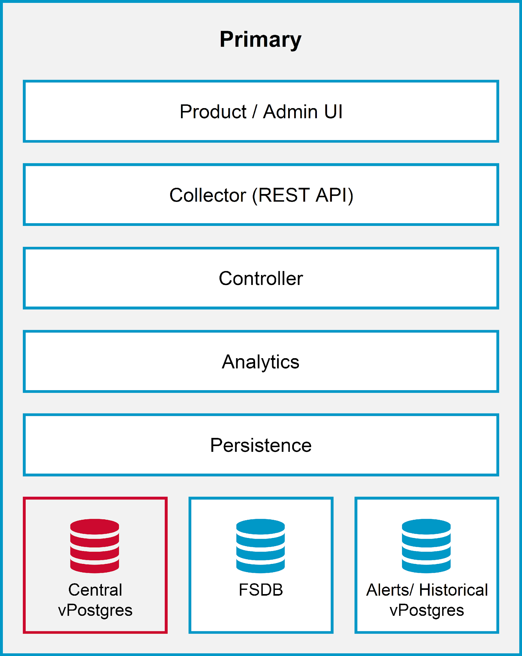
Understanding the Primary Node
A cluster can contain single or multiple VCF Operations nodes. The first VCF Operations node that you deploy is called the primary node.
The primary node is the required initial node in a VCF Operations cluster. It has the following functions and characteristics:
Collects and processes incoming data and performs administration for the cluster
Contains the central vPostgres database
Can function as a network time protocol (NTP) server
All the components of the VCF Operations software stack are implemented in the primary node. Additional node types have a subset of the components.
Notes:
TalkTrack:
In a VCF Operations cluster, you can have either a single node or multiple nodes, with the very first one deployed being designated as the primary node. This primary node is a fundamental and mandatory component for the VCF Operations cluster to function. Its responsibilities are multifaceted: it collects and processes all incoming data, performs critical administrative tasks for the entire cluster, and notably, houses the central vPostgres database where essential operational data resides. Additionally, the primary node is capable of functioning as a Network Time Protocol, or NTP, server, ensuring time synchronization across the environment. It's important to note that the primary node fully implements all components of the VCF Operations software stack, providing a comprehensive set of functionalities. Other node types in the cluster, in contrast, will only contain a subset of these components, relying on the primary node for core services.
<End>

Slide 21
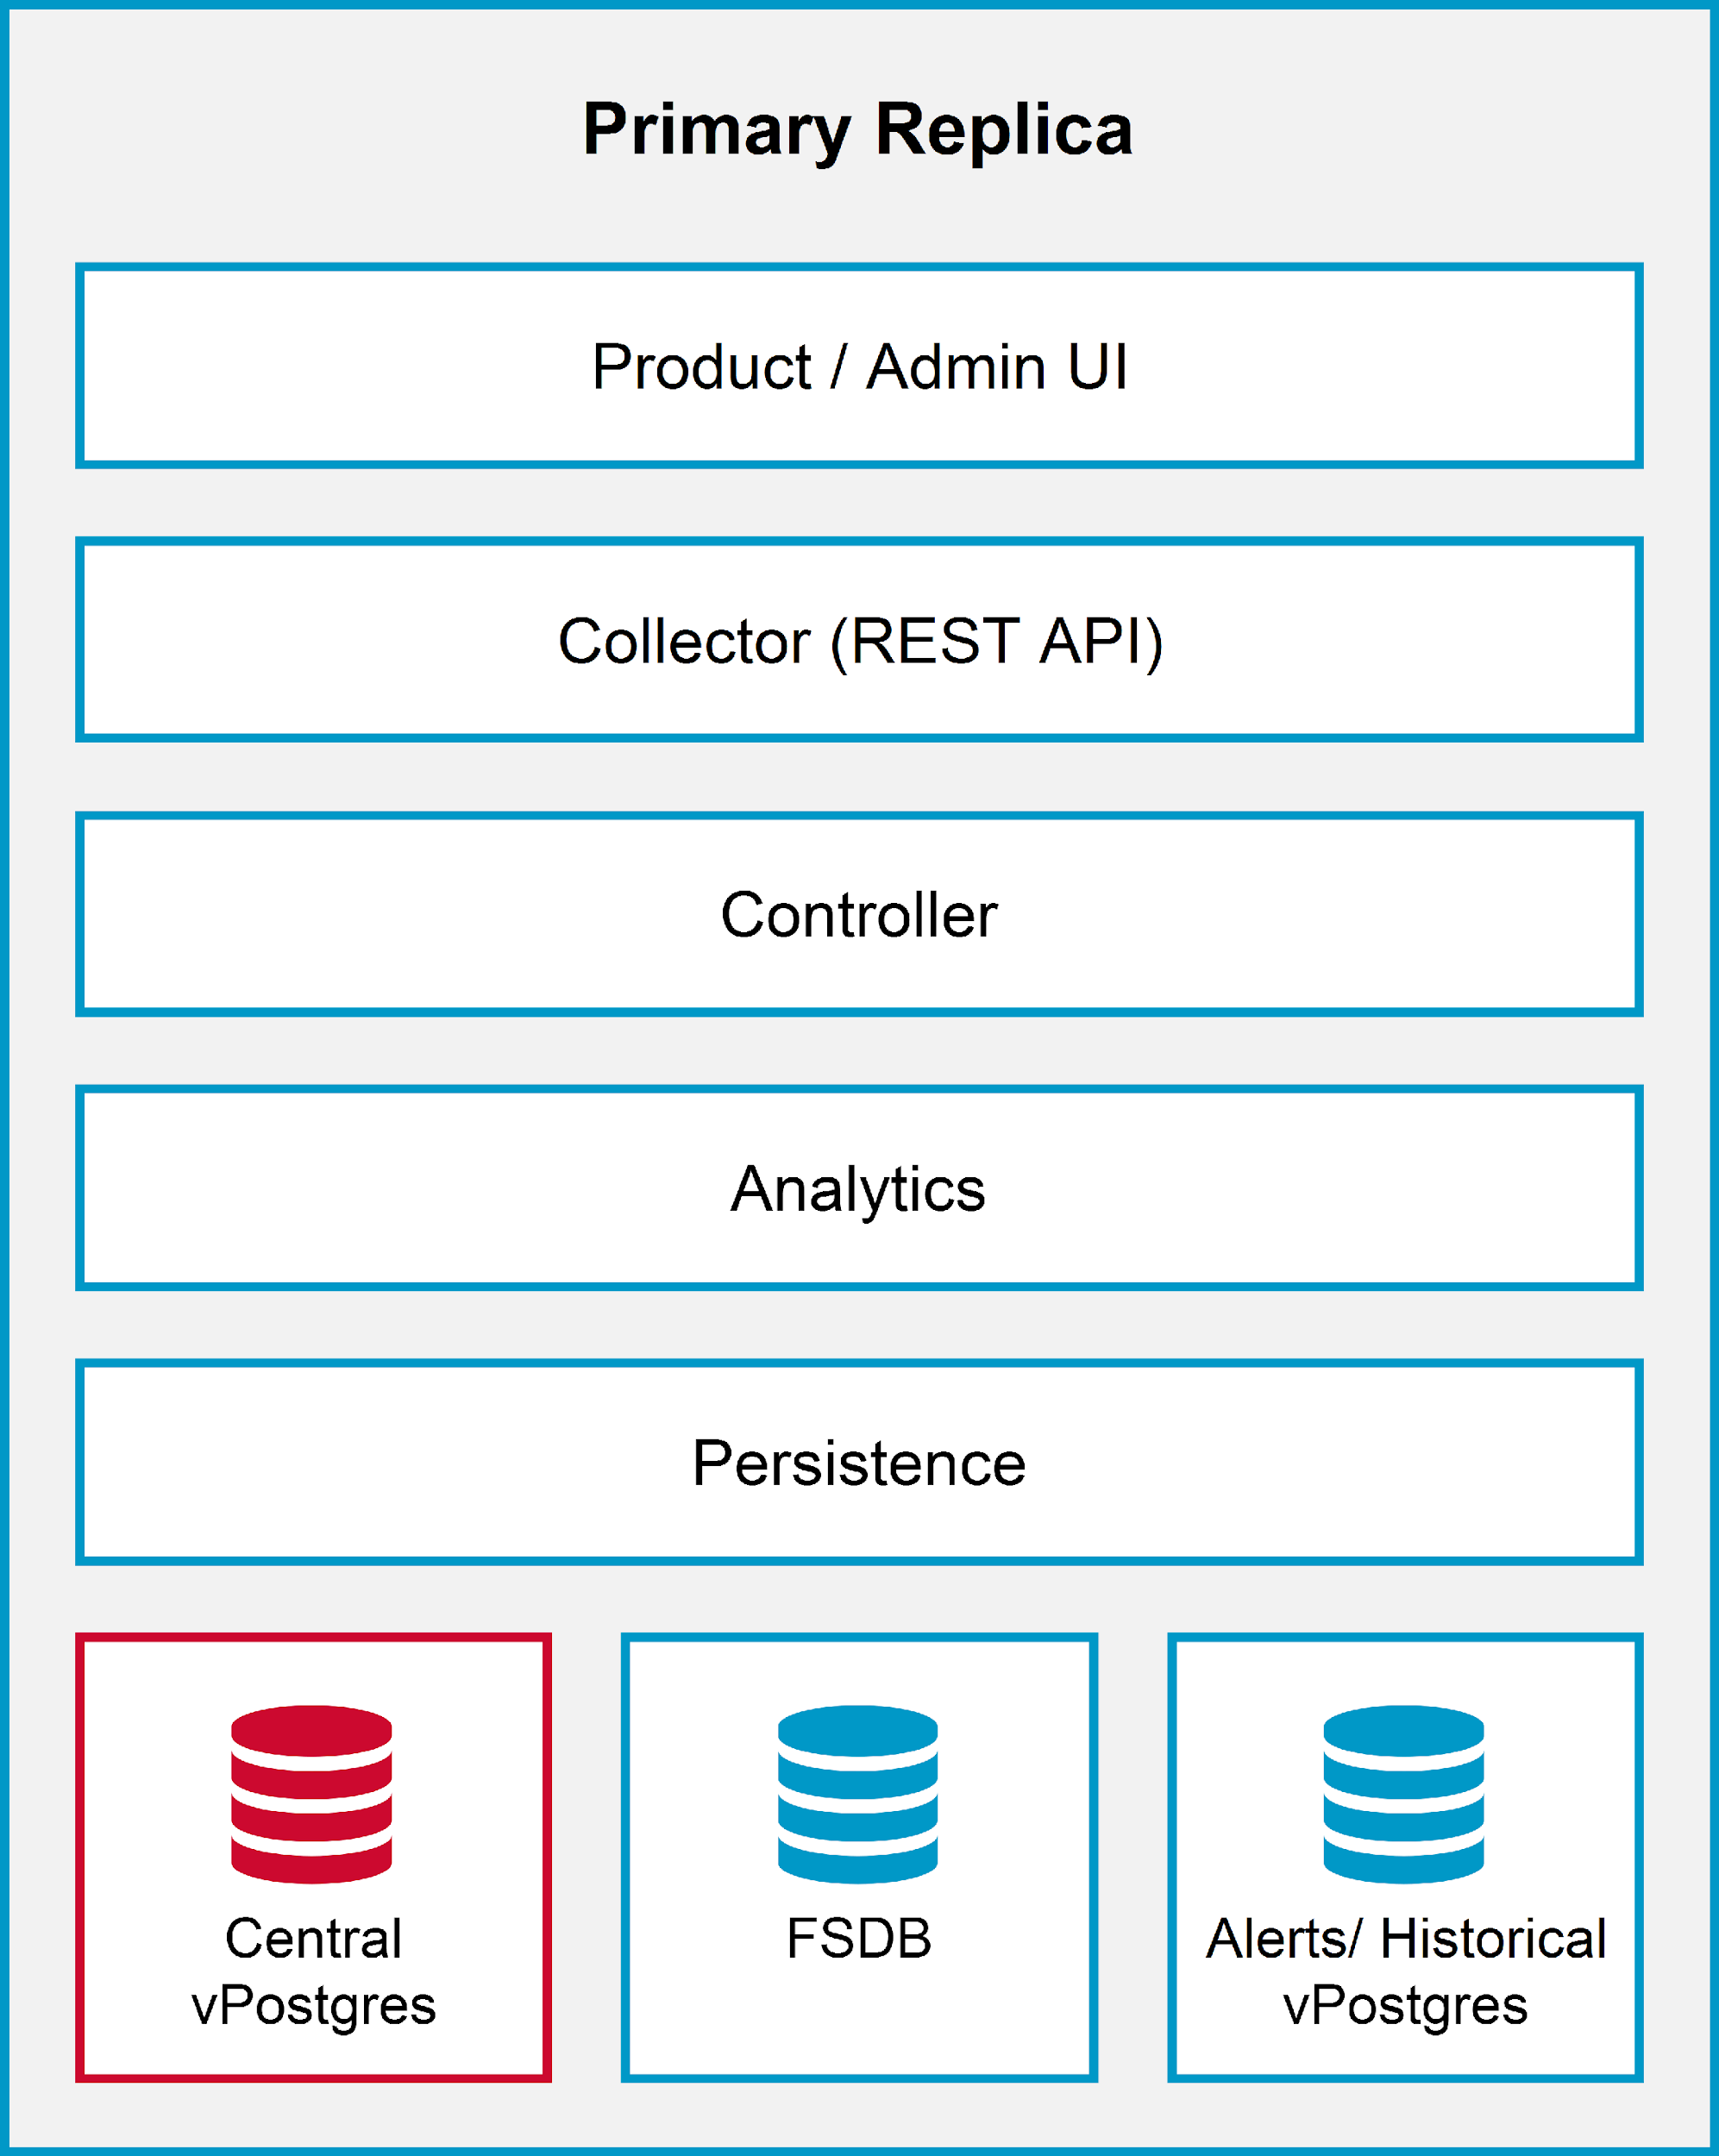
Understanding the Primary Replica Node Role
VCF Operations supports high availability by enabling a primary replica node for the VCF Operations primary node.
The primary replica node receives redundant copies of data from the primary node.
Notes:
TalkTrack:
To ensure high availability and resilience within your VCF Operations deployment, the system supports the implementation of a primary replica node. This replica node acts as a standby for the primary VCF Operations node, forming a robust High Availability (HA) pair. A crucial function of the primary replica node is to continuously receive and store redundant copies of all data from the active primary node. This redundancy is vital for disaster recovery and business continuity, as it allows for a seamless failover in the event of an issue with the primary node. Should the primary node become unavailable, the primary replica can be promoted to take over its functions, minimizing downtime and ensuring uninterrupted operations and data integrity. Essentially, it mirrors the primary node's architecture, as depicted, including its components like the Product/Admin UI, Collectors, Controllers, Analytics, and Persistence layers, as well as the databases like Central vPostgres, FSDB, and Alerts/Historical vPostgres.
<End>

Slide 22
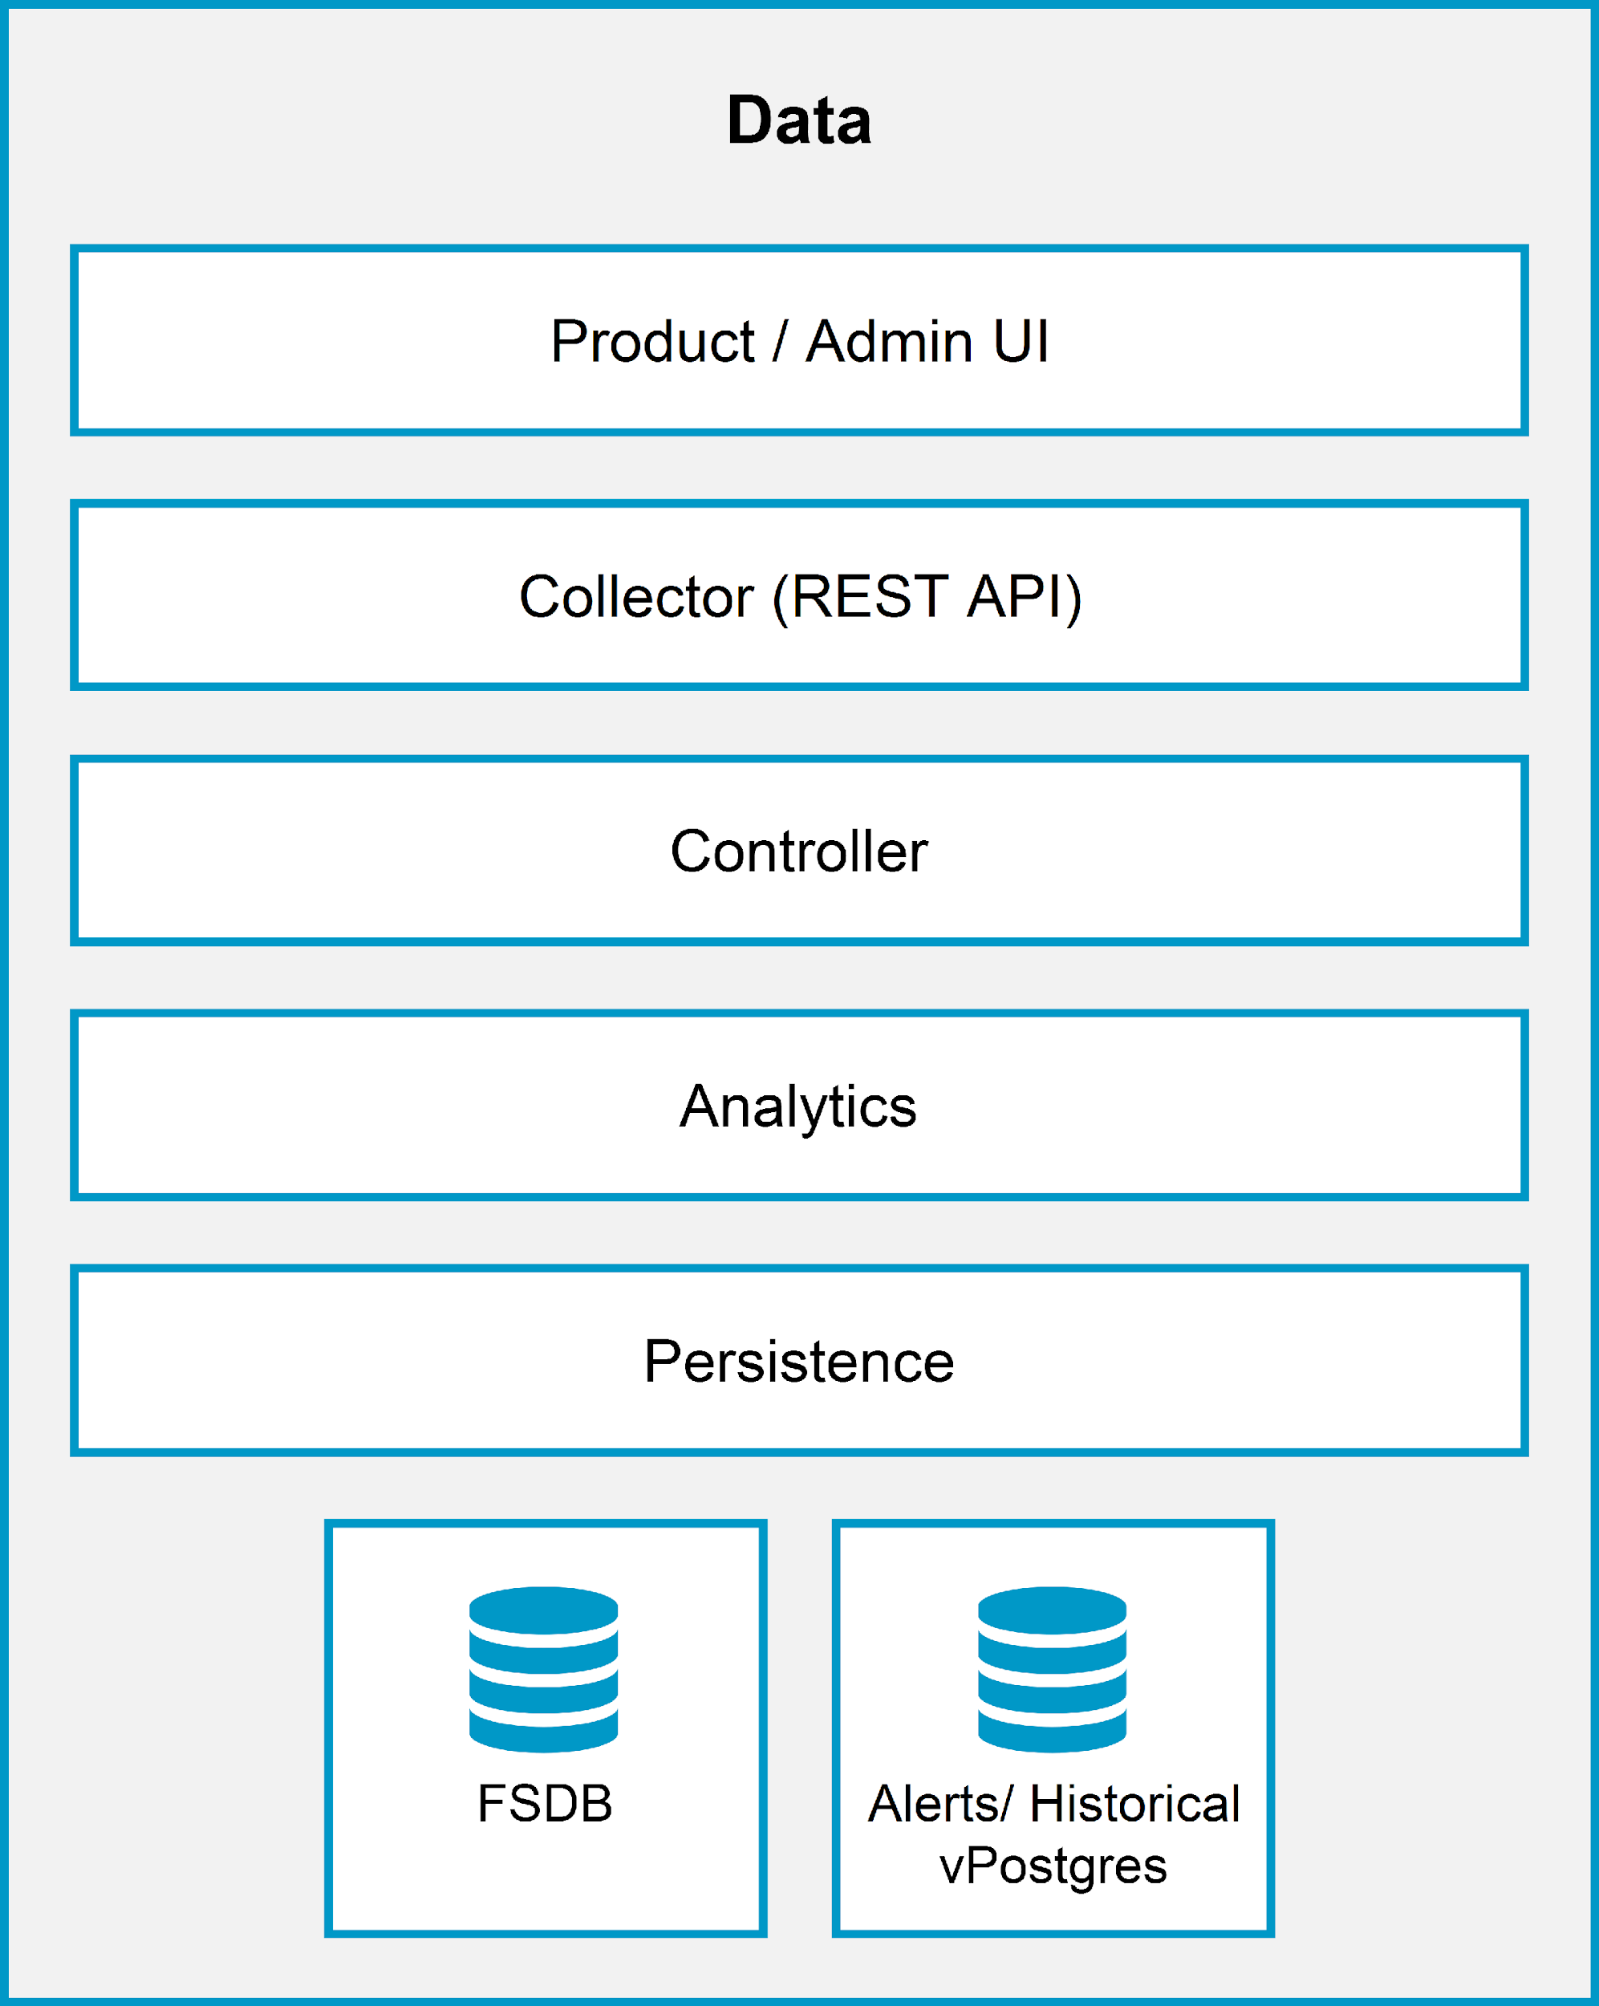
Understanding the Data Node Role
The data node has a similar architecture to the primary node and primary replica node. However, the data node does not have a central vPostgres database and cannot act as an NTP server.
The data node provides the core database functionality of collecting and processing the incoming data.
Notes:
TalkTrack:
Moving beyond the primary and primary replica nodes, we now delve into the role of the data node within a VCF Operations cluster. While the data node shares a similar architectural structure with both the primary and primary replica nodes in terms of components like the Product/Admin UI, Collector, Controller, Analytics, and Persistence, there are two crucial distinctions. Firstly, a data node does not host the central vPostgres database, which remains exclusive to the primary node for centralized data management. Secondly, unlike the primary node, a data node cannot function as an NTP server. Its primary purpose is to provide the core database functionality specifically for collecting and processing the vast amounts of incoming operational data. These nodes are essential for scaling out the data processing and storage capabilities of the VCF Operations environment, distributing the workload and ensuring efficient handling of large data volumes without burdening the primary node's core administrative functions.
<End>

Slide 23
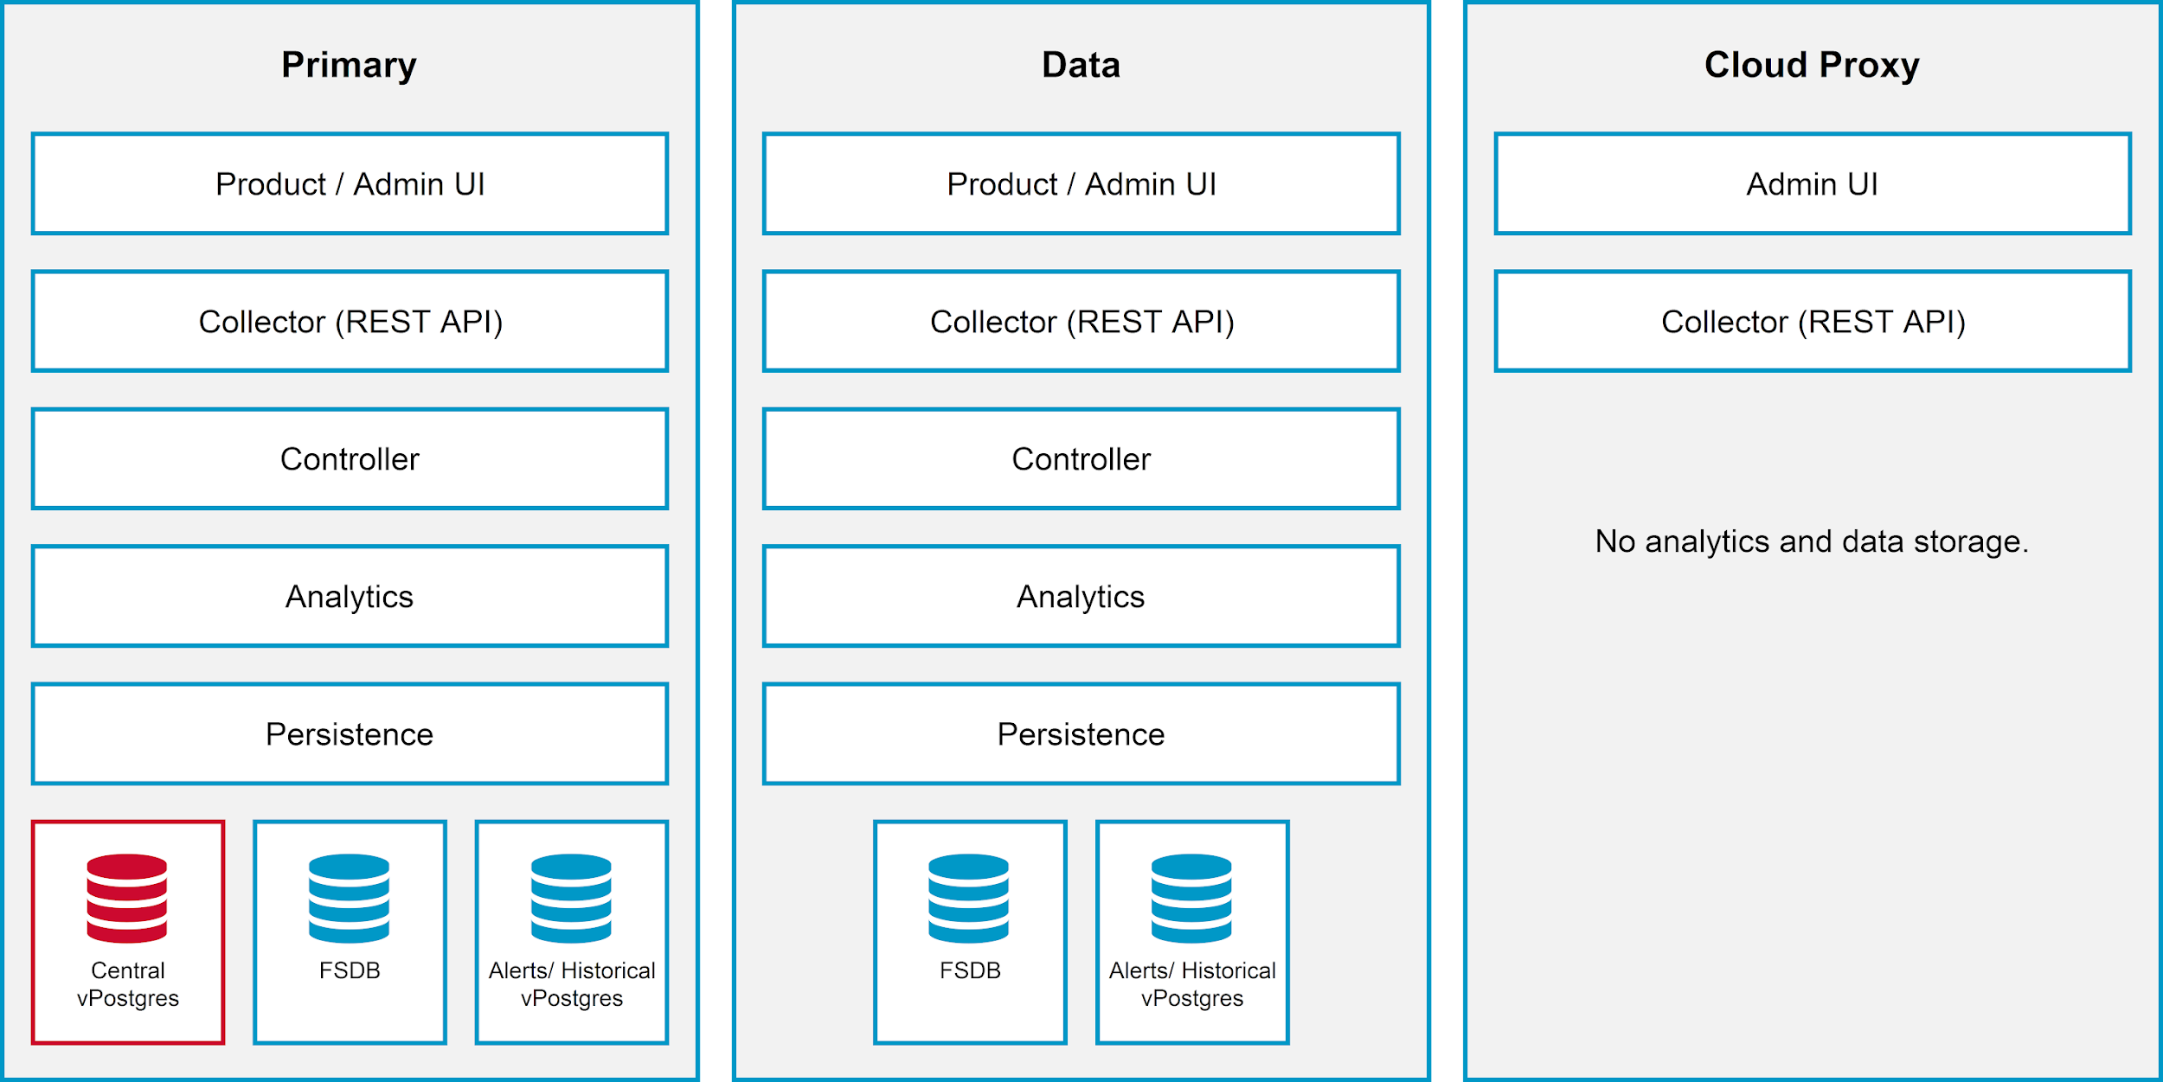
Understanding the Cloud Proxy Role
A Cloud Proxy node is an extra cluster node that allows VCF Operations to gather more objects in its inventory for monitoring.
Notes:
TalkTrack:
Beyond the core primary and data nodes, VCF Operations introduces the Cloud Proxy node, which serves as an essential extension to your cluster. Its primary purpose is to enable VCF Operations to gather a wider range of objects into its inventory for comprehensive monitoring. As illustrated, the Cloud Proxy's architecture is more lightweight compared to the primary or data nodes. It includes components such as an Admin UI and a Collector (REST API). However, a key distinction is that the Cloud Proxy node does not perform analytics or data storage functions. It acts as a secure, remote collection point, allowing VCF Operations to extend its reach into isolated networks or specific segments of your infrastructure without deploying full-fledged primary or data nodes in those locations. This design ensures efficient data collection while maintaining the centralized processing and storage capabilities on your primary and data nodes.
<End>

Slide 24
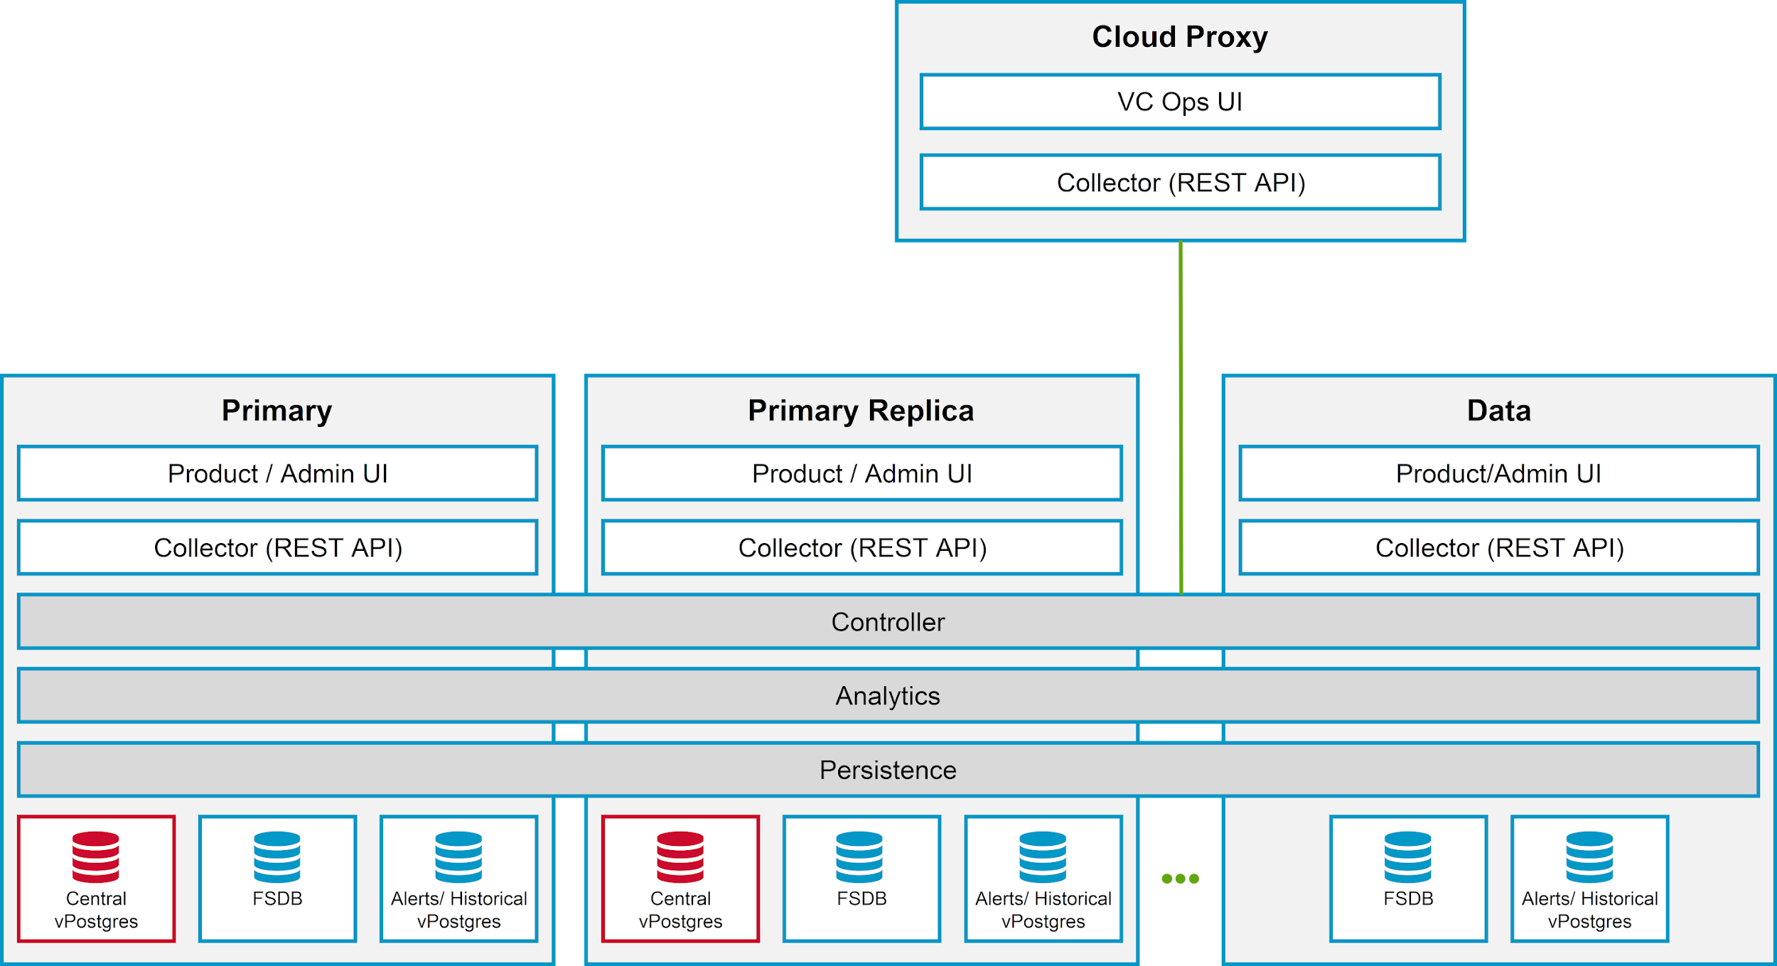
Understanding the Multinode Cluster
You can create a single-node or multiple node cluster depending on your environment.
Every node in the cluster is assigned one or more of these roles:
Primary
Primary Replica
Data
Cloud Proxy
The primary, primary replica, and data nodes collectively called analytics nodes.
Notes:
TalkTrack:
This slide provides a comprehensive overview of how VCF Operations supports both single-node and multi-node cluster deployments, adapting to diverse environmental requirements. In a multi-node configuration, each node within the cluster is assigned one or more specific roles: Primary, Primary Replica, Data, or Cloud Proxy. As we've discussed, the Primary node serves as the initial, mandatory component, housing the central vPostgres database and performing cluster administration. The Primary Replica node provides crucial high availability by maintaining redundant data copies. Data nodes are responsible for scaling data collection and processing, handling incoming operational data. Lastly, Cloud Proxy nodes extend the monitoring reach of VCF Operations into various network segments. Collectively, the primary, primary replica, and data nodes are referred to as analytics nodes, underscoring their combined role in processing and analyzing the operational data. The diagram visually represents how these different node types interact and contribute to the overall VCF Operations cluster functionality, highlighting their respective components and how they fit into the larger architecture.
<End>

Slide 25
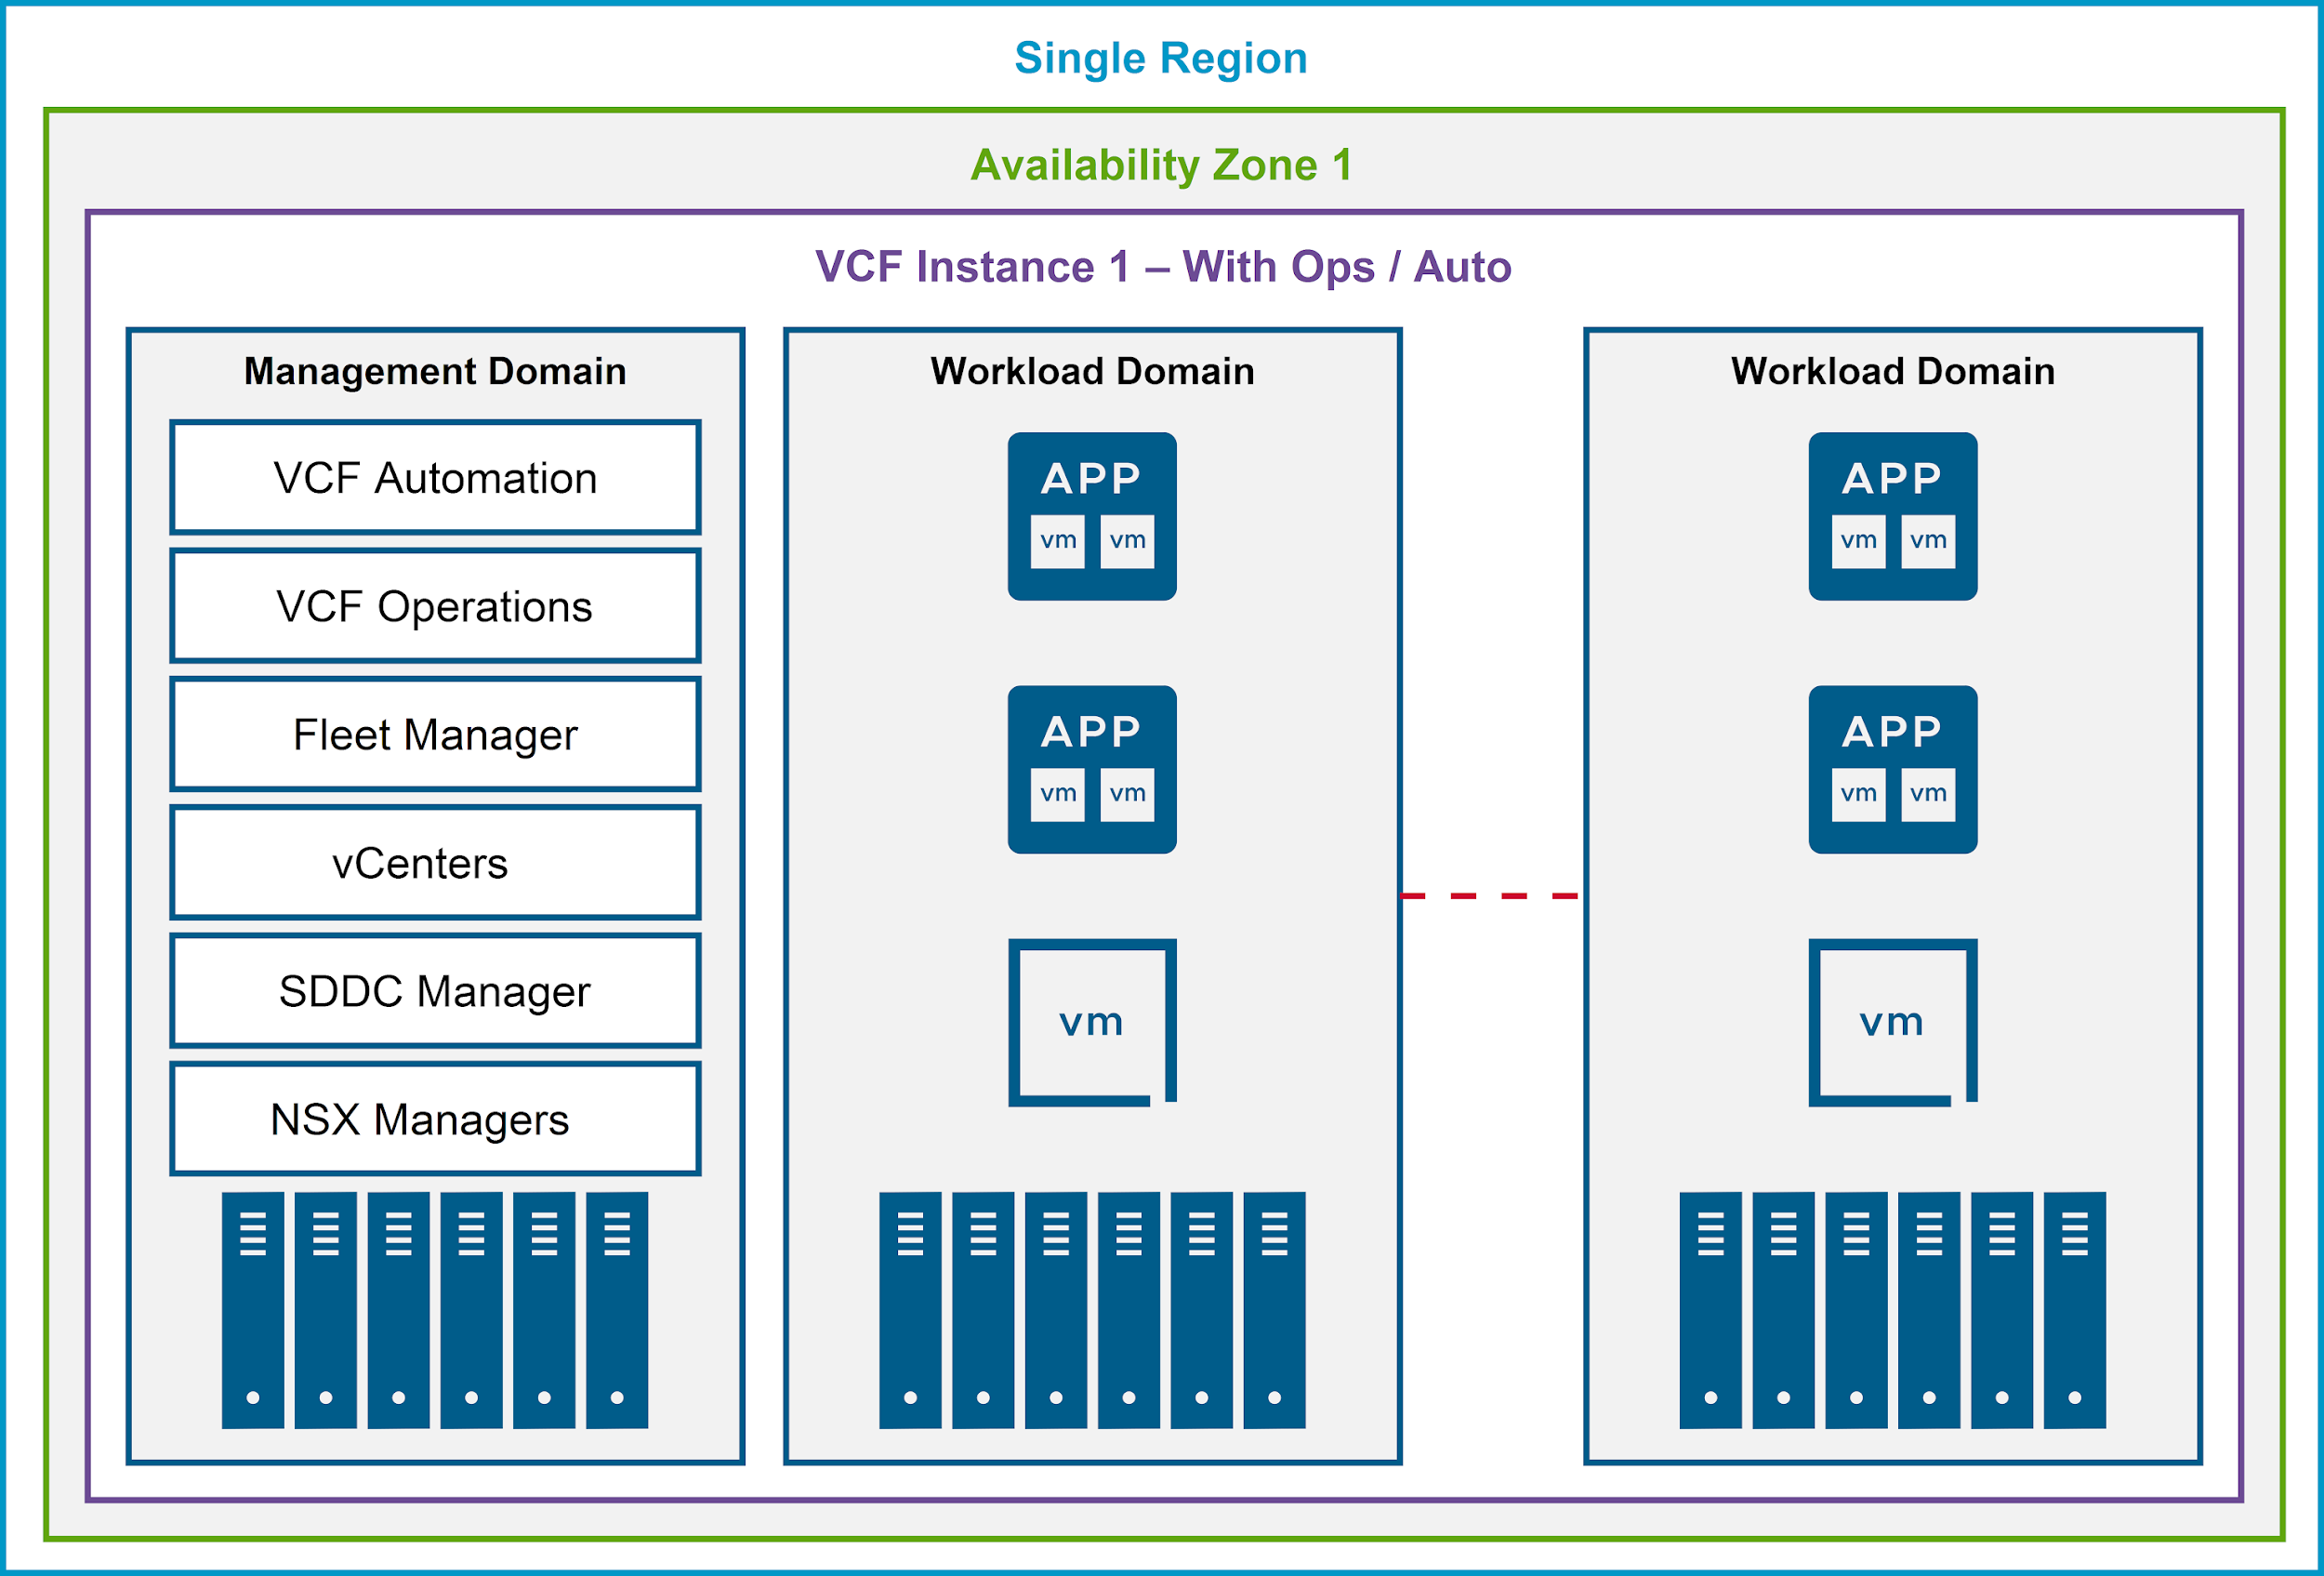
VCF Operations Design: Single Region - Single Availability Zone
In a single region - single availability zone (AZ):
A single VCF Operations instance is used for fleet management.
A single VCF Automation instance is used to consume and automate private cloud resources across all VCF instances.
VCF Operations and VCF Automation instances are deployed to the management domain of the initial VCF instance.
Notes:
TalkTrack:
This slide introduces a common deployment design for VCF Operations, focusing on a single region with a single availability zone. In this architecture, a singular VCF Operations instance is deployed, acting as the centralized hub for comprehensive fleet management across the environment. This instance provides all the monitoring, troubleshooting, and optimization capabilities we've discussed previously. Concurrently, a single VCF Automation instance is used to consume and automate private cloud resources, extending its reach across all VCF instances within this deployment. This integration streamlines the provisioning and management of cloud resources. Critically, both the VCF Operations and VCF Automation instances are strategically deployed directly into the management domain of the initial VCF instance. This co-location within the management domain ensures tight integration, efficient communication, and simplified management of the core cloud infrastructure and its operational tools. The accompanying diagram visually depicts this architecture, showing the management domain hosting these key components alongside various workload domains, all within a unified single region and availability zone.
<End>

Slide 26
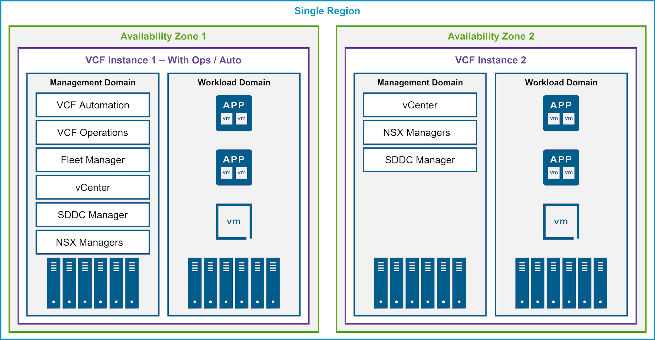
Basic Fleet Management Design: Single Region - Multi AZ
In a single region - multi AZ:
A single VCF Operations and Automation instance manages the entire fleet.
VCF Operations collector is deployed to VCF Instance 2 if network latency is above 500 ms.
Notes:
TalkTrack:
Here we delve into a more complex, yet common, VCF Operations deployment design: a single region configured with multiple availability zones. In this architecture, a single VCF Operations and Automation instance is still leveraged to manage the entire fleet, providing centralized control and observability across the distributed infrastructure. The key difference here is the geographical distribution of VCF instances across distinct availability zones within that single region, enhancing resilience and fault tolerance. As depicted in the diagram, VCF Instance 1, which includes both VCF Operations and Automation components within its Management Domain, resides in Availability Zone 1. VCF Instance 2, while also containing its own Management and Workload Domains, is situated in Availability Zone 2. A critical consideration for this multi-AZ deployment is network latency: if the latency between these instances, particularly to VCF Instance 2, exceeds 500 milliseconds, it becomes necessary to deploy a dedicated VCF Operations collector to VCF Instance 2. This ensures efficient and reliable data collection despite the increased network distance, maintaining optimal performance for monitoring and management across both availability zones. This design is ideal for organizations requiring higher levels of business continuity and disaster recovery within a localized geographical area.
<End>

Slide 27
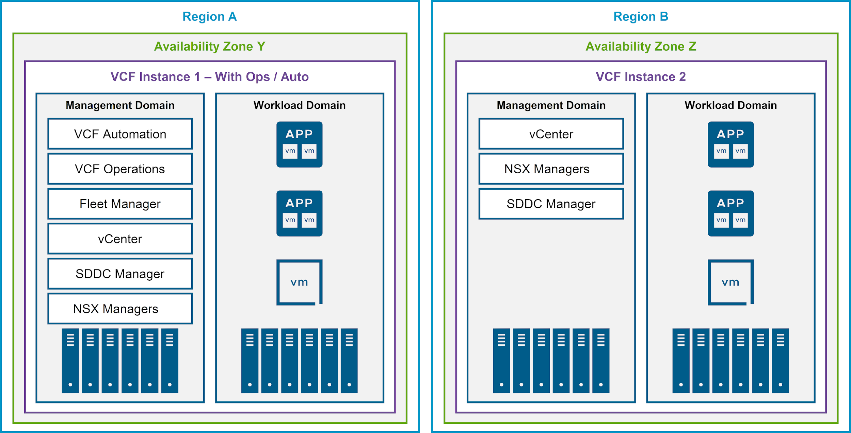
Basic Fleet Management Design: Multi Region - Multi AZ
A single VCF Operations and Automation instance managing the entire fleet is not changed by extending to another region:
Continue to maintain a single VCF Operations instance in region A.
Add a VCF Operations collector instance to region B if network latency is above 500 ms.
Notes:
TalkTrack:
Let's advance our discussion on VCF Operations deployment designs to a multi-region, multi-Availability Zone (AZ) architecture. A key principle here is that extending your environment to another region does not necessitate deploying a completely separate VCF Operations and Automation instance for each region. Instead, you continue to maintain a single, central VCF Operations instance, typically located in your primary Region A, which continues to manage the entire fleet centrally. This centralized approach simplifies management and provides a unified view across geographically dispersed infrastructures. However, a crucial consideration when extending to multiple regions is network latency. If the network latency between your primary VCF Operations instance in Region A and the new VCF Instance in Region B exceeds 500 milliseconds, it becomes essential to deploy an additional VCF Operations collector directly into Region B. This local collector ensures efficient data gathering and reduces the impact of high latency on monitoring and management operations within Region B, maintaining performance and responsiveness for critical operational tasks. The diagram visually represents this distributed architecture, showcasing VCF Instance 1 with Operations and Automation in Region A, and VCF Instance 2 in a distinct Region B, both contributing to the overall managed fleet.
<End>

Slide 28
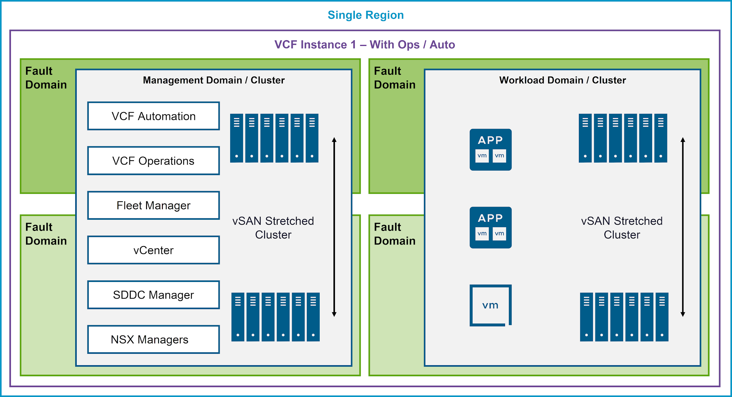
VCF Fleet with Fault Domains Design
A single VCF Operations and Automation instance manages the entire fleet.
Notes:
TalkTrack:
This slide presents an advanced VCF Operations deployment design that incorporates fault domains, specifically leveraging vSAN stretched clusters for enhanced resilience. In this architectural model, a single VCF Operations and Automation instance is still capable of managing the entire fleet, providing centralized control even within a highly resilient, distributed setup. The core concept here revolves around fault domains, which are logical groupings of physical infrastructure designed to tolerate localized failures, such as a rack or even an entire site going down. As shown in the diagram, both the Management Domain and the Workload Domain are configured as clusters spanning across two distinct fault domains. This is achieved through a vSAN Stretched Cluster configuration, where storage is synchronously replicated between the fault domains. For the Management Domain, key components like VCF Automation, VCF Operations itself, Fleet Manager, vCenter, SDDC Manager, and NSX Managers are distributed across these fault domains, ensuring that a failure in one domain does not incapacitate the entire management plane. Similarly, within the Workload Domain, applications and virtual machines are deployed across the vSAN Stretched Cluster, providing continuous availability for your critical workloads. This design significantly enhances the overall fault tolerance and disaster recovery capabilities of your VCF environment within a single region, allowing operations to continue seamlessly even during major infrastructure disruptions within one of the fault domains.
<End>

Slide 29
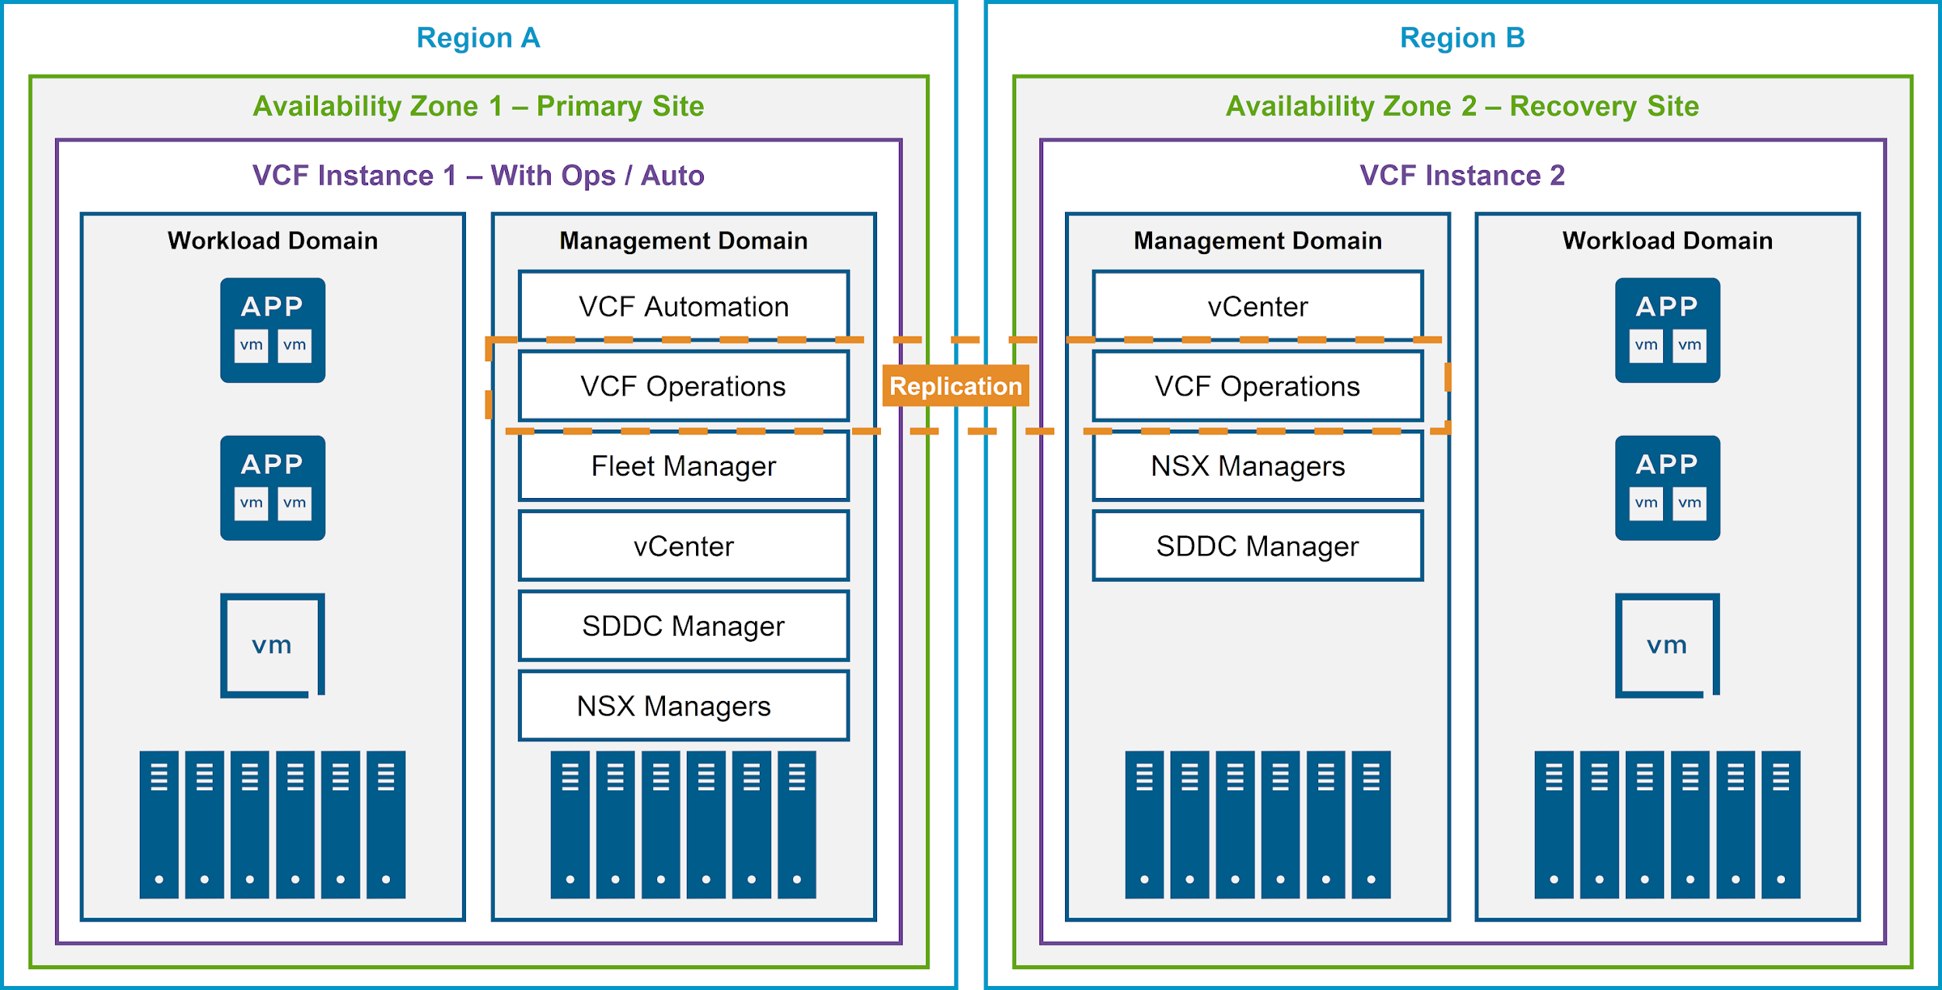
Fleet with Disaster Recovery Management Design
For the design of a fleet with DR management, the guidance for VCF Operations remains unchanged from VCF 5.2.
Notes:
TalkTrack:
This slide focuses on designing a VCF fleet with robust disaster recovery capabilities. It's important to note that for VCF Operations specifically, the core guidance for DR management largely remains consistent with that from VCF 5.2, indicating a mature and stable approach to protecting your operational insights. As depicted in the diagram, this design typically involves a primary site in Region A, Availability Zone 1, and a recovery site in Region B, Availability Zone 2. In Region A, you'll find VCF Instance 1, which hosts both VCF Operations and VCF Automation within its Management Domain, alongside the Workload Domain. For disaster recovery, key management components such as vCenter, NSX Managers, and SDDC Manager from Region A are replicated or extended to Region B, creating VCF Instance 2 as your recovery site. The diagram highlights a "Replication" link, specifically showing VCF Operations and Fleet Manager as components that would be part of this replication or DR strategy to ensure that your operational management capabilities are also resilient and available at the recovery site. This design ensures that in the event of a disaster at the primary site, your VCF operations, including fleet management and automation, can be restored and continued from the designated recovery site, minimizing downtime and data loss for critical management functions.
<End>

Slide 30
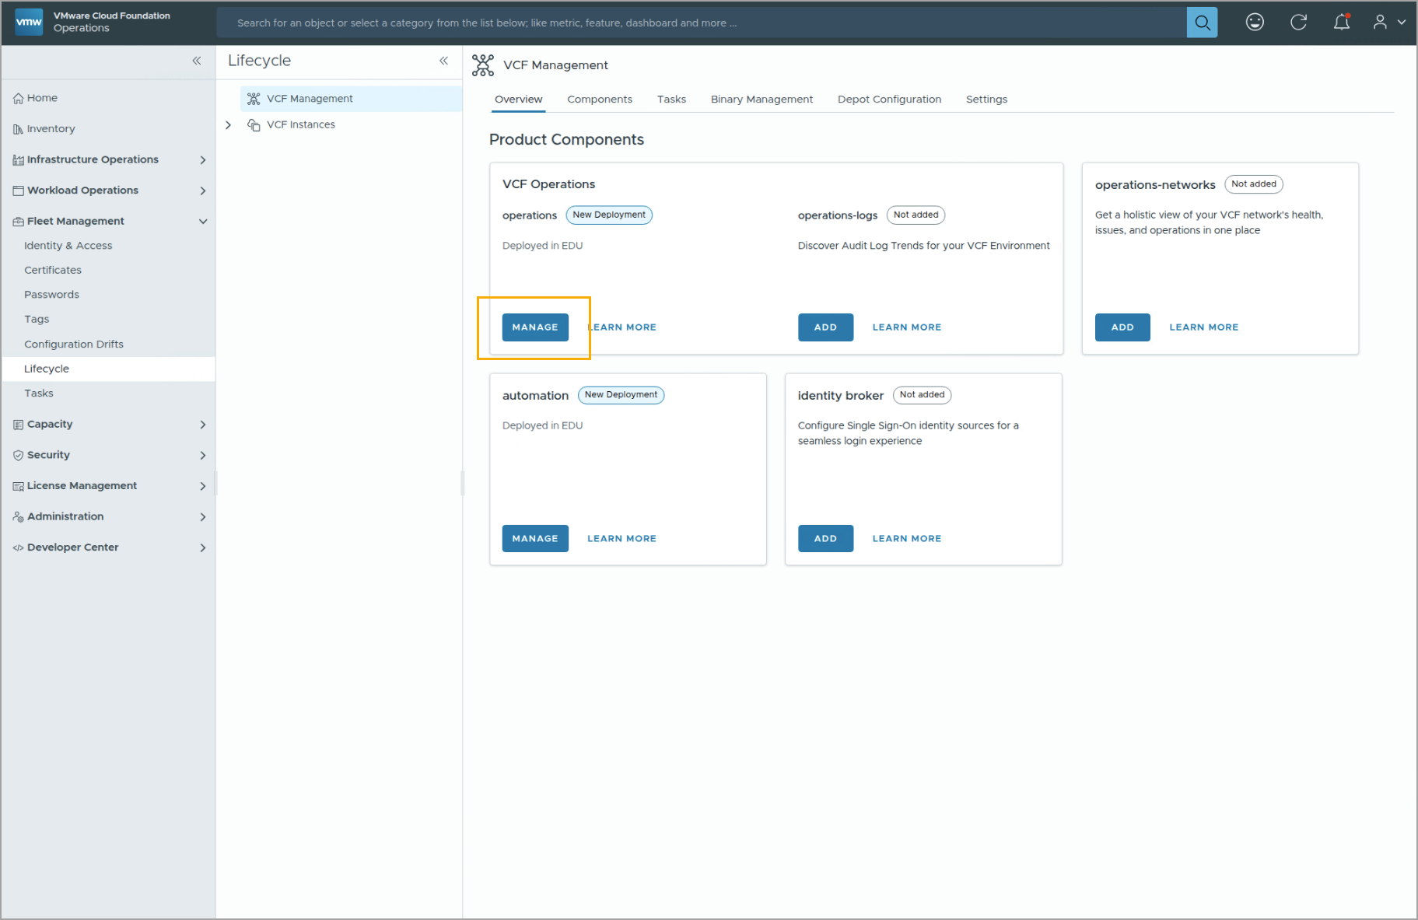
Examining a VCF Operations Cluster
You can examine and manage VCF Operations clusters in the VCF Operations console. To do so, navigate to Fleet Management > Lifecycle and click Manage under the VCF Operations cluster. You can then view the components, nodes, collector groups, and topology of the selected operations cluster.
Notes:
TalkTrack:
This slide provides practical guidance on how to examine and manage your VCF Operations clusters directly within the VCF Operations console. To access these functionalities, you will navigate through the console's menu: first, go to Fleet Management, then select Lifecycle. Within the Lifecycle section, you'll find an option to Manage your VCF Operations cluster. Clicking this will bring you to a detailed view where you can explore various aspects of your selected operations cluster. This includes viewing individual components of the cluster, understanding the configuration of node collector groups, and visualizing the overall topology of your VCF Operations deployment. This centralized management capability allows administrators to gain deep insights into the health, configuration, and interconnections of their VCF Operations environment, facilitating effective monitoring and troubleshooting.
<End>

Slide 31
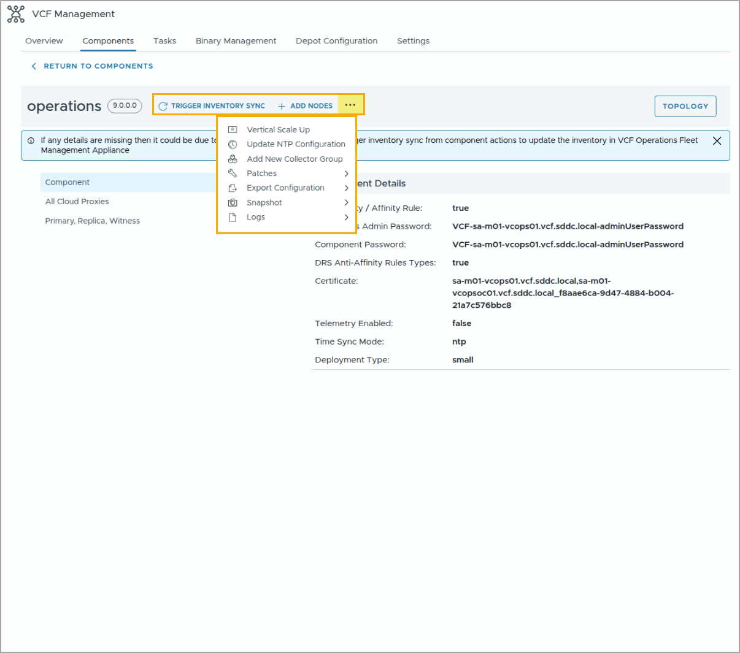
Managing a VCF Operations Cluster
You can manage an existing VCF Operations cluster:
Trigger Inventory Sync: Allows you to sync all the components
Update NTP Configuration
Add Nodes: Allows you to add more nodes to this VCF Operations cluster
Add New Collector Group
Patches: Allows you to install patches and review patch history
Export Configuration: Allows you to export the VCF Operations cluster configuration to a JSON file
Snapshot: Allows you to create and manage snapshots of the VCF Operations cluster
Logs: Allows you to generate, download, and delete logs for this cluster
Notes:
TalkTrack:
This slide delves into the various management capabilities available for an existing VCF Operations cluster directly from the console. Once you have examined your cluster, as discussed previously, you can perform several key operational tasks to maintain and evolve your environment. One important function is "Trigger Inventory Sync," which ensures that all components within your VCF Operations cluster are fully synchronized with their latest states and configurations. You also have the ability to "Update NTP Configuration," which is crucial for maintaining accurate time synchronization across your distributed environment, a foundational aspect for consistent logging and performance data. For scalability, the "Add Nodes" option allows you to seamlessly expand your VCF Operations cluster by integrating new nodes. Related to this, "Vertical Scale Up" provides options to enhance the resources of existing nodes, should your operational demands increase. Furthermore, you can "Add New Collector Groups" to customize and optimize data collection from specific parts of your infrastructure. The "Patch" function enables you to install updates and review the history of previously applied patches, ensuring your system remains secure and up-to-date. For configuration management and auditing, you can "Export Configuration" of your VCF Operations cluster to a JSON file. "Snapshot" capabilities allow for creating and managing snapshots of the cluster, offering a point-in-time recovery option. Lastly, the "Logs" function provides the means to generate, download, and delete logs, which are indispensable for troubleshooting and auditing purposes within your VCF Operations environment. These functions collectively provide a comprehensive toolkit for proactive and reactive cluster management.
<End>

Slide 32
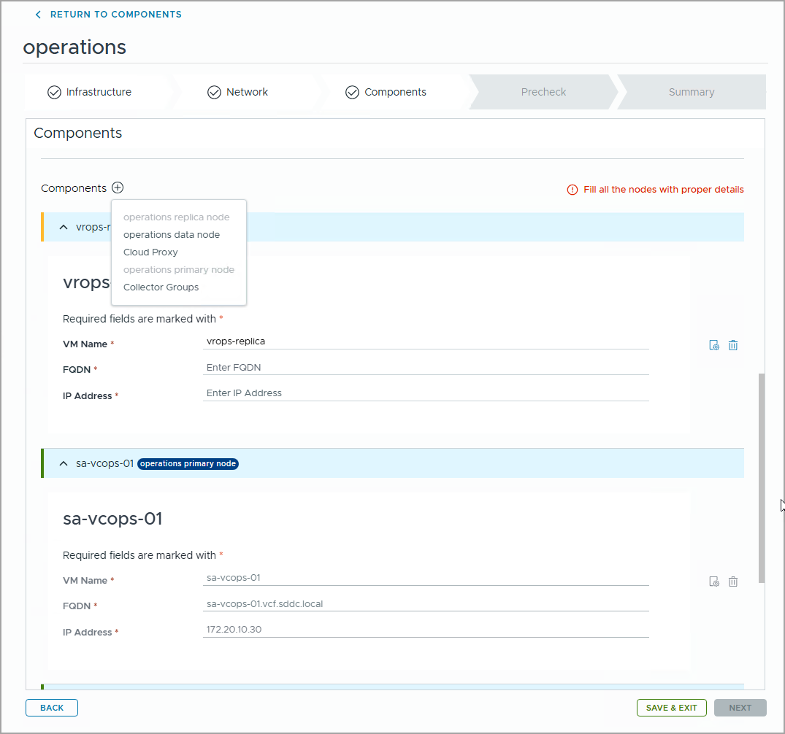
Adding Nodes to a VCF Operations Cluster
You can use the Add Nodes function to deploy more nodes to an existing VCF Operations cluster:
Primary replica: You can add at most one primary replica node.
Data: You can add more than one data node to a VCF Operations cluster.
Cloud Proxy: You can add more than one cloud proxy to a VCF Operations cluster.
Collector Groups: You can add more than one collector group to a VCF Operations cluster.
For each newly added node, you need to specify its VM name, FQDN, and IP address.
Notes:
TalkTrack:
This slide elaborates on the process of scaling out your VCF Operations cluster by adding new nodes, a capability we briefly touched upon in the previous discussion on cluster management. The "Add Nodes" function within the console allows you to deploy various types of additional nodes to an existing VCF Operations cluster to enhance its capacity and resilience. Specifically, you can add at most one primary replica node, which is essential for ensuring high availability of your primary VCF Operations instance. For scaling out data processing and storage, you have the flexibility to add multiple data nodes to your cluster. Furthermore, to extend your monitoring reach into various network segments or isolated environments, you can deploy multiple cloud proxy nodes. The system also allows you to add more than one collector group, providing granular control over data collection policies and sources. For each new node that is added, it is crucial to accurately specify its virtual machine name, fully qualified domain name, and IP address within the wizard. It's important to remember that a VCF Operations cluster is designed to scale up to a maximum of 10 nodes in total. This capability allows you to grow your VCF Operations environment to meet increasing demands and operational requirements.
<End>
Before starting any node operation, it is recommended to perform an inventory sync. This is because sometimes a drift or change can exist in the environment outside VCF Operations Fleet Management appliance, and for VCF Operations Fleet Management appliance to know the current state of the system, its inventory needs to be up to date.

Slide 33
Review of Learner Objectives
Identify the components of a VCF Operations node
Describe the different roles of the node in a VCF Operations cluster

Slide 34
VCF Operations Navigation

Slide 35
Learner Objectives
Perform basic VCF Operations console navigation
List the different management areas in the VCF Operations UI

Slide 36
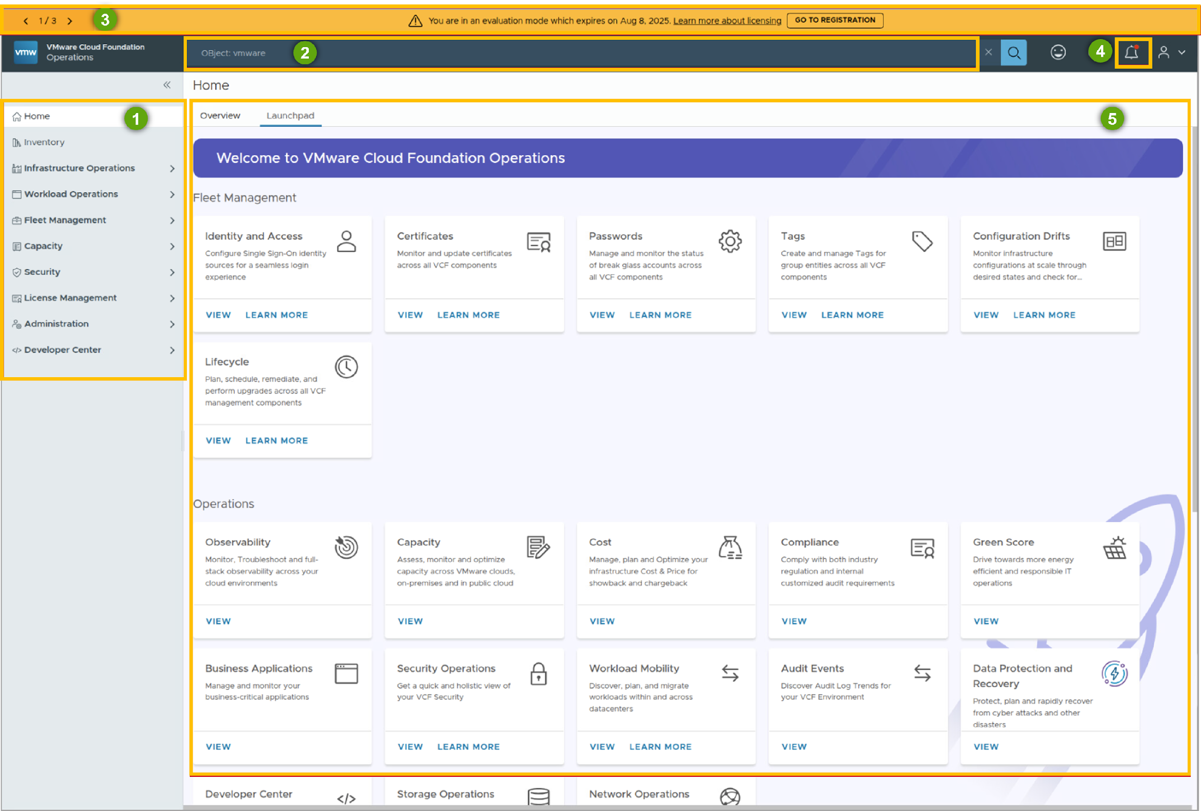
VCF Operations Console Navigation
Administrators perform major day-to-day tasks in the VCF Operations console.
The console contains the following core elements:
Navigation menu: Allows you to navigate the different operations management domains.
Search bar: Allows you to easily find objects in your environment.
Warning message banner: Displays important and mission-critical messages.
Collection notifications: Allow you to monitor the status of data collection and adaptors.
Operations screen: Allows you to perform tasks, processes, and management.
Notes:
TalkTrack:
The VCF Operations console serves as the central point for administrators to perform major day to day tasks. A navigation menu facilitates movement between different operations management domains. A search bar allows for easy location of objects within the environment. Important and mission critical messages display through a warn message banner. Collection notifications provide status updates on data collection and adaptors. The operations screen enables the execution of tasks, processes, and overall management.
<End>

Slide 37
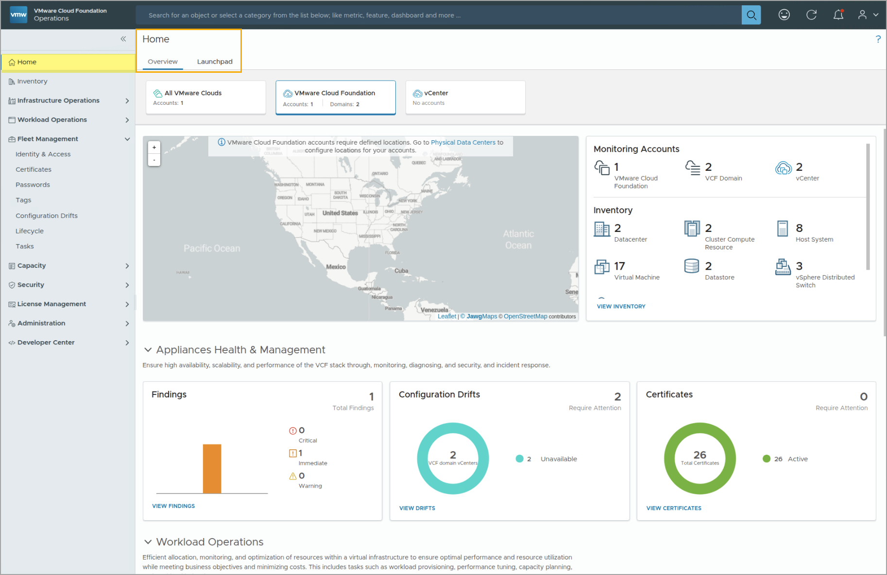
VCF Operations Home Page
The Home page appears when you log in to the product UI for the first time. The Home page contains two tabs: Overview and Launchpad.
Notes:
TalkTrack:
Upon initial login to the product user interface, the VCF Operations Home page loads. This home page is organized into two primary tabs: Overview and Launchpad.
<End>

Slide 38
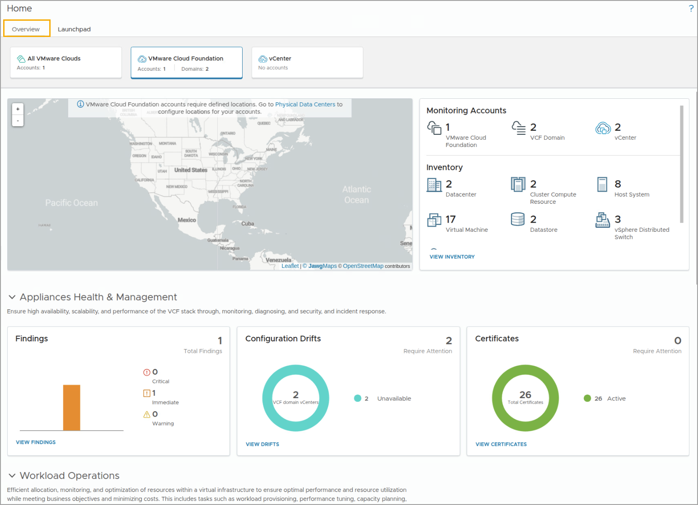
Home Page: Overview
The Overview tab on the Home page gives you a high-level summary of your entire infrastructure. You can view high-level information about the following categories:
VCF deployment and domain
Configuration drifts
Certificates
Workload operations
Alerts
Cost and capacity
Compliance
Notes:
TalkTrack:
The Overview tab on the home page provides a high level summary of the entire infrastructure. High level information categories include VCF deployment and domain, configuration drifts, and certificates. Workload operations, alerts, cost and capacity, and compliance are also viewable. The overview page offers a comprehensive understanding of cloud accounts, showing geo-location, top objects or services, and alerts. Capacity and remaining time, along with costs for VMware Cloud Infrastructure or individual VMware clouds, are also available. Populating these pages requires adding cloud accounts.
<End>
The Overview page provides a comprehensive understanding of your cloud accounts, which includes their geo-location, top objects or services, and alerts. You can also view the capacity and time remaining and the cost for your entire VMware Cloud infrastructure or individual VMware clouds.
You need to add cloud accounts to populate these pages with information.

Slide 39
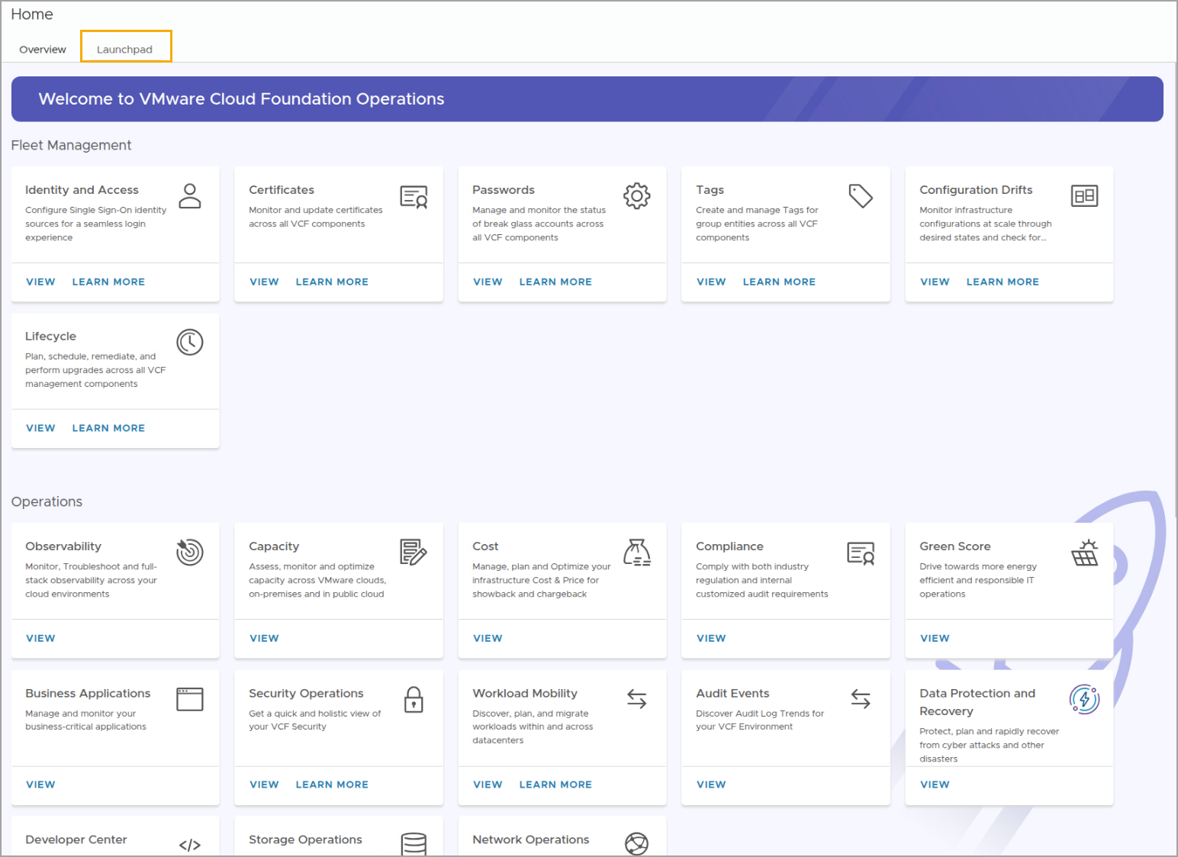
Home Page: Launchpad
The Launchpad tab on the Home page allows you to quickly access the various pillars of operations.
The capabilities of VCF Operations are categorized into separate pillars of operations. These pillars enable you to manage configurations, optimize performance, optimize capacity, and troubleshoot issues.
Notes:
TalkTrack:
The Launchpad tab, found under the Home page, provides quick access to various pillars of operations. The capabilities of VCF Operations are categorized into these separate pillars. These pillars facilitate the management of configurations, performance optimization, capacity optimization, and troubleshooting of issues.
<End>

Slide 40
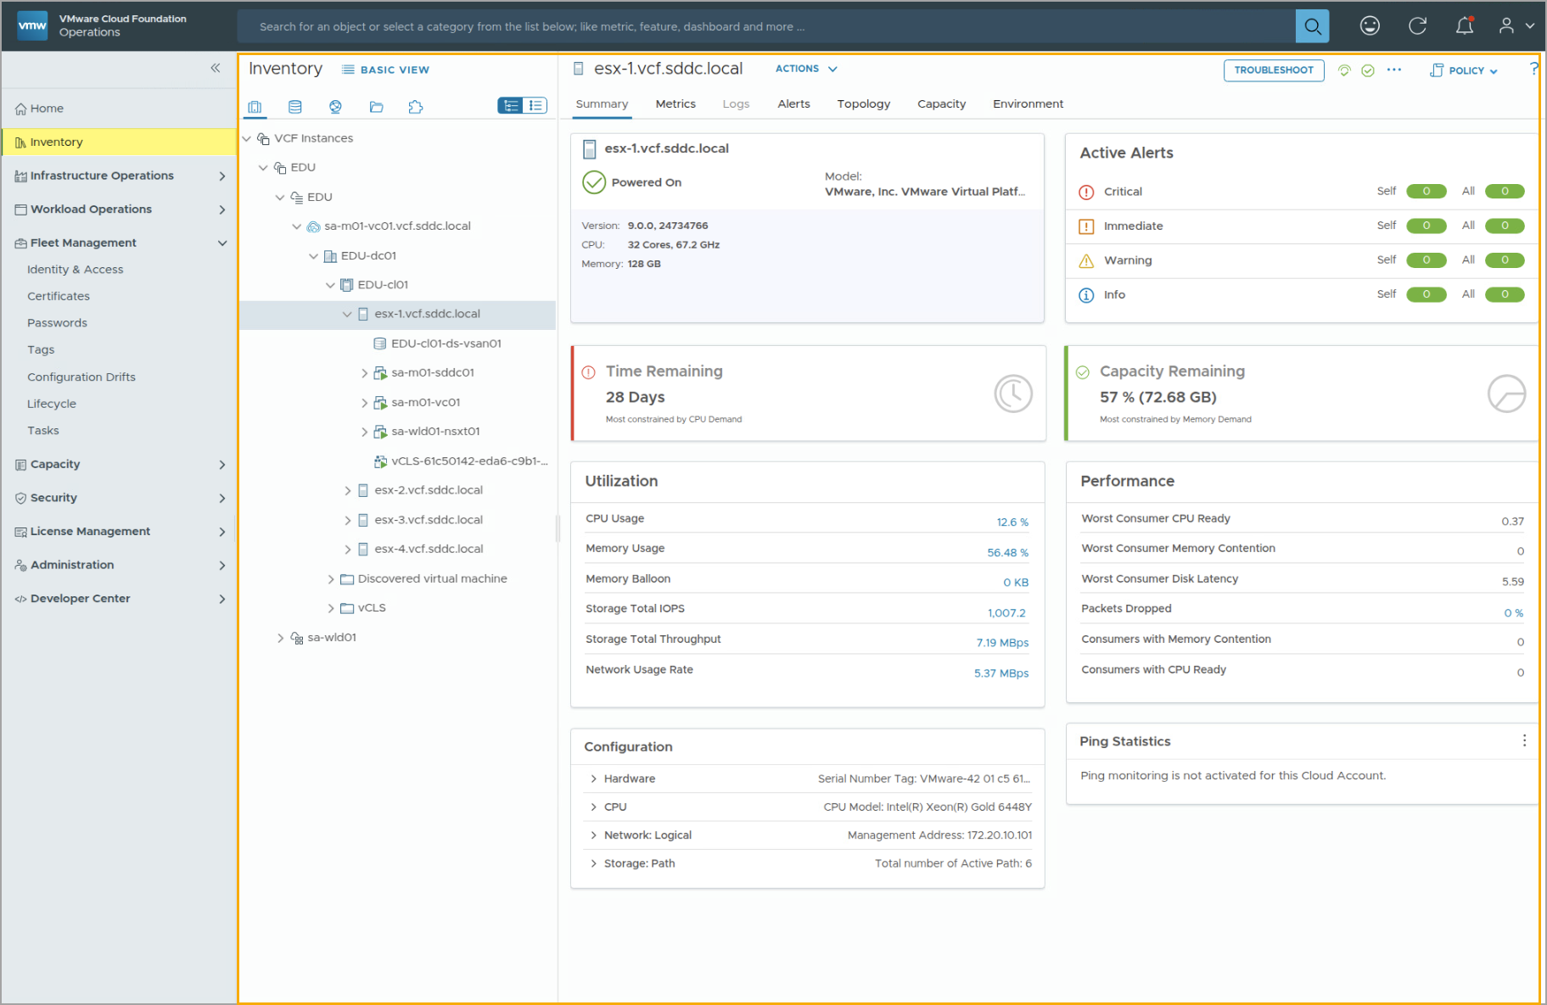
Inventory Page
The Inventory page allows you to view objects in your entire fleet and infrastructure, such as domains, VMs, data stores, networks, and groups.
You can view and interact with the metrics, alerts, topology, and logs associated with each object.
Notes:
TalkTrack:
The Inventory page allows viewing of objects in the entire fleet and infrastructure. This includes domains, virtual machines, datastores, networks, and groups. Metrics, alerts, topology, and logs associated with each object are viewable and interactive. To display the correct inventory list, the corresponding account information must be added to VCF Operations. For example, adding a vCenter account to the VCF Operations console will enable VCF Operations to display data and inventory tracking.
<End>
In order to show the correct inventory list on the Inventory page, you must add the corresponding account information to VCF Operations. For example, you can add vCenter account to your VCF Operations console, and VCF Operations will then be able to display data and inventory tracking in the VCF Operations console.

Slide 41
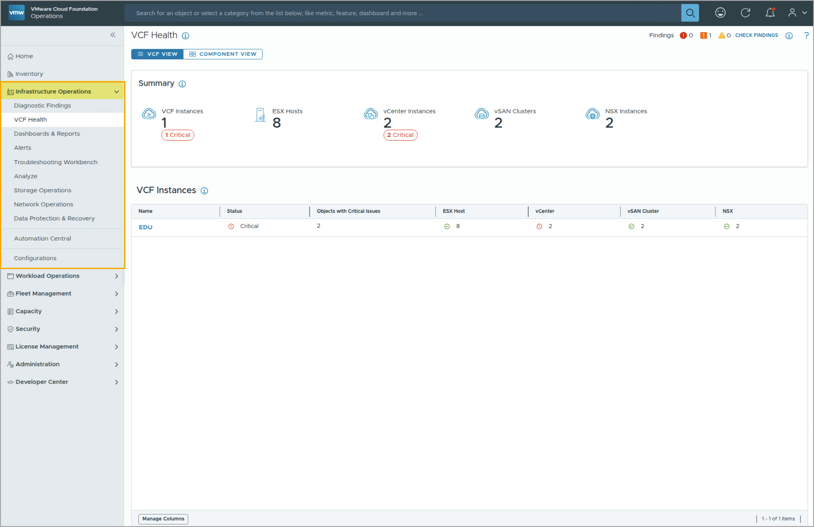
Infrastructure Operations
The Infrastructure Operations page allows you to monitor the entire infrastructure, including VMs, storage, network, licenses, and more.
You can set up dashboards and reports to display the data you deem important to infrastructure health and resources optimization.
You can also activate alerts to capture specific issues or irregular symptoms and use troubleshooting benchmarks to help resolve outstanding issues.
Notes:
TalkTrack:
The Infrastructure Operations page provides monitoring of the entire infrastructure. This includes virtual machines, storage, network, licenses, and other components. Dashboards and reports are configurable to display data crucial for infrastructure health and resource optimization. Alerts can be activated to capture specific issues or irregular symptoms. Troubleshooting benchmarks assist in resolving outstanding issues.
<End>

Slide 42
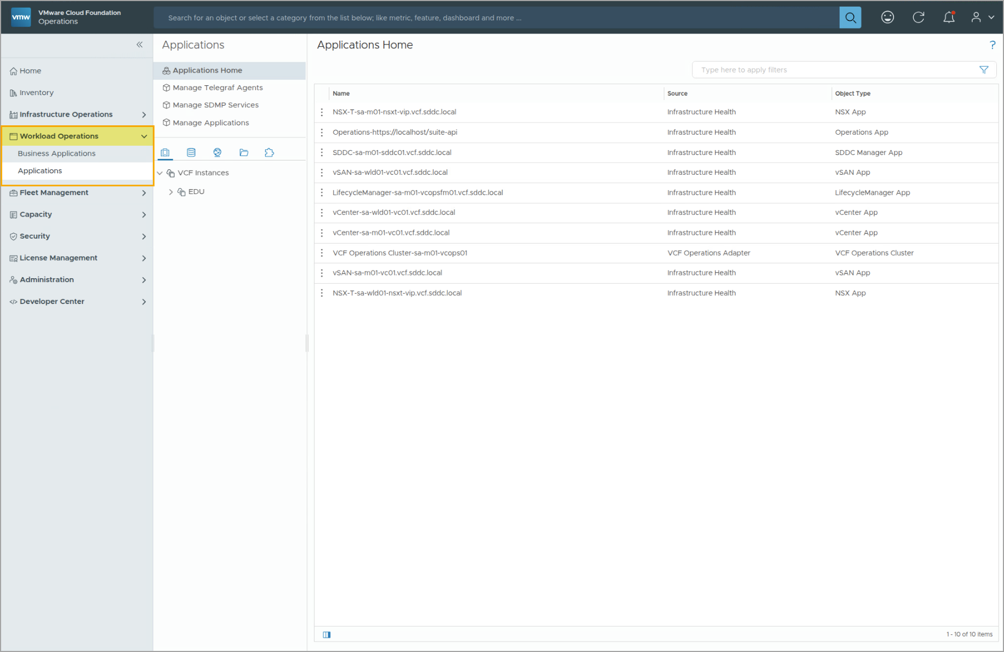
Workload Operations
The Workload Operations page allows you to monitor the status of applications, services running in provisioned guest operations systems, and services running in your virtual environment.
Some application monitoring is achieved through the Telegraf agent. You can use options in the Workload Operations menus to deploy the Telegraf agents to the target virtual machines.
Notes:
TalkTrack:
The Workload Operations page enables monitoring of applications and services. This includes services running within provisioned guest operating systems and those in the virtual environment. Application monitoring can be achieved using the Telegraf agent. The Workload Operations menus provide options to deploy Telegraf agents to target virtual machines.
<End>

Slide 43
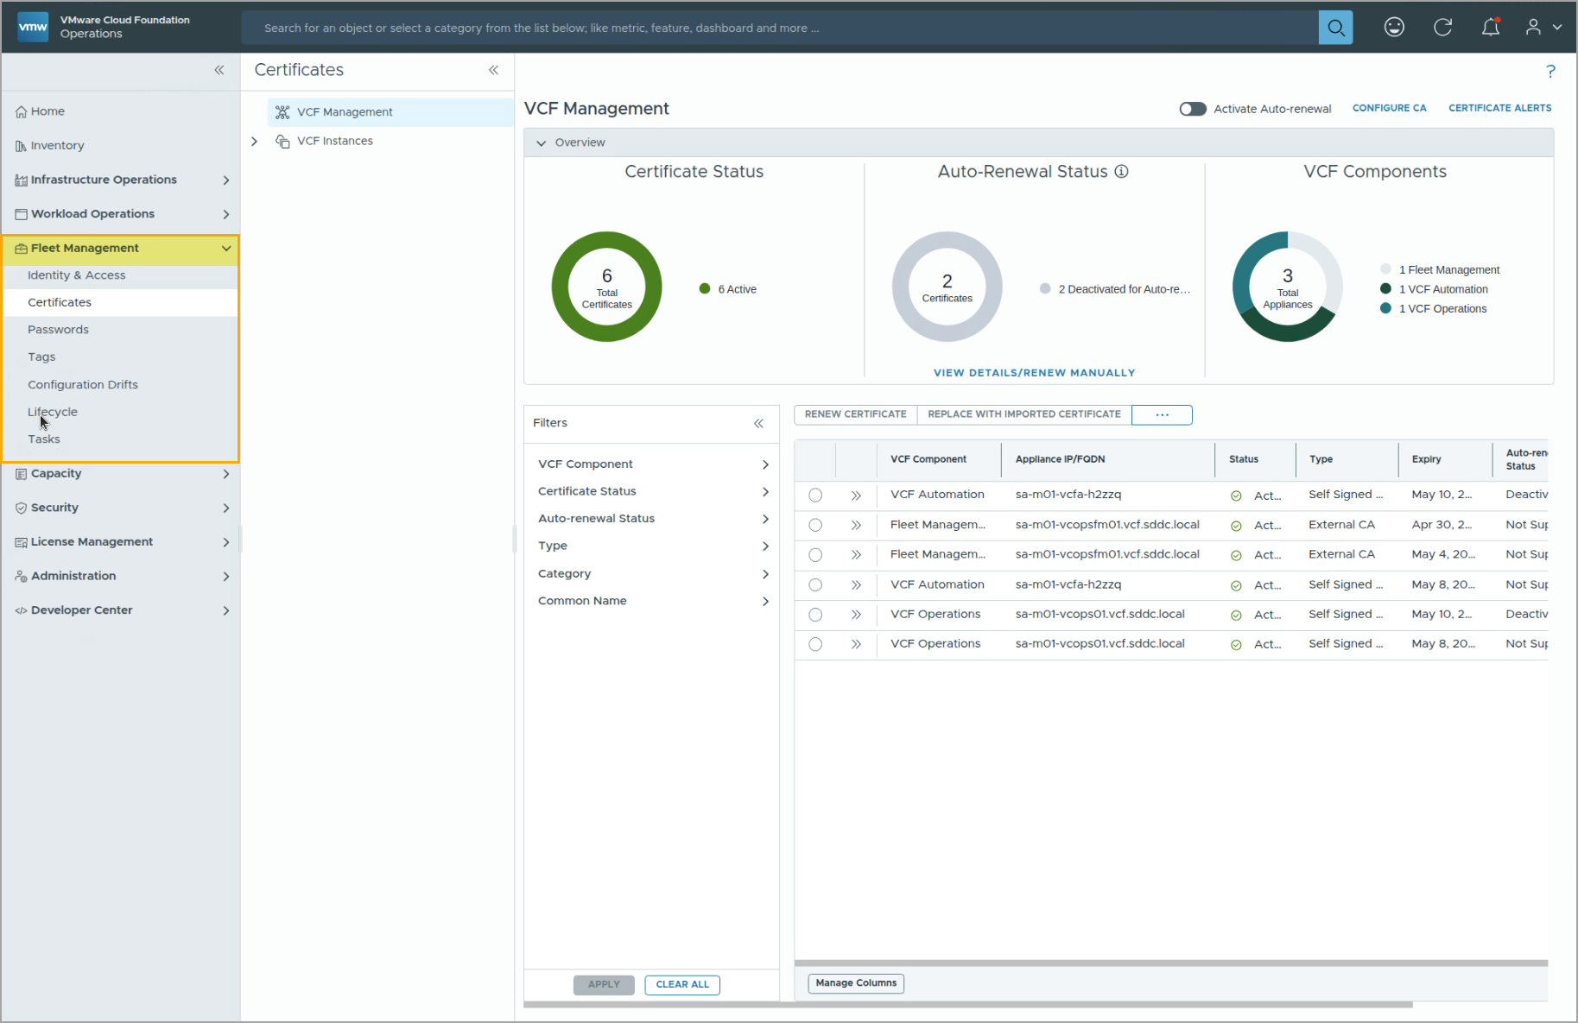
Fleet Management
The Fleet Management page allows you to manage your VCF deployment and your VCF Operations nodes with the following capabilities:
Identity & Access
Certificates
Passwords
Tags
Configuration Drifts
Lifecycle
Tasks
Notes:
TalkTrack:
The Fleet Management page allows for managing the VCF deployment and VCF Operations nodes. Capabilities include Identity & Access, which configures Single Sign On (SSO) for VCF components using one set of credentials. Certificates are viewable, renewable, or replaceable for each VCF component. Root and local admin passwords for each VCF component are managed. Tags are created and managed to group objects by their logical function. Configuration drifts are captured and remediated. Lifecycle management deploys and manages VCF capabilities, such as automation and additional SSO identity brokers. The status of initiated tasks is monitored.
<End>
Identity & Access: Configures SSO to access VCF components with one set of credentials.
Certificates: Views, renews, or replaces the certificate for each VCF component.
Passwords: Manages the root and local admin password for each VCF component.
Tags: Creates and manages tags to group objects by their logical function.
Configuration Drifts: Captures and remediates configuration drifts.
Lifecycle: Deploys and manages VCF capabilities, such as automation and additional SSO identity broker.
Tasks: Monitors the status of initiated tasks.

Slide 44
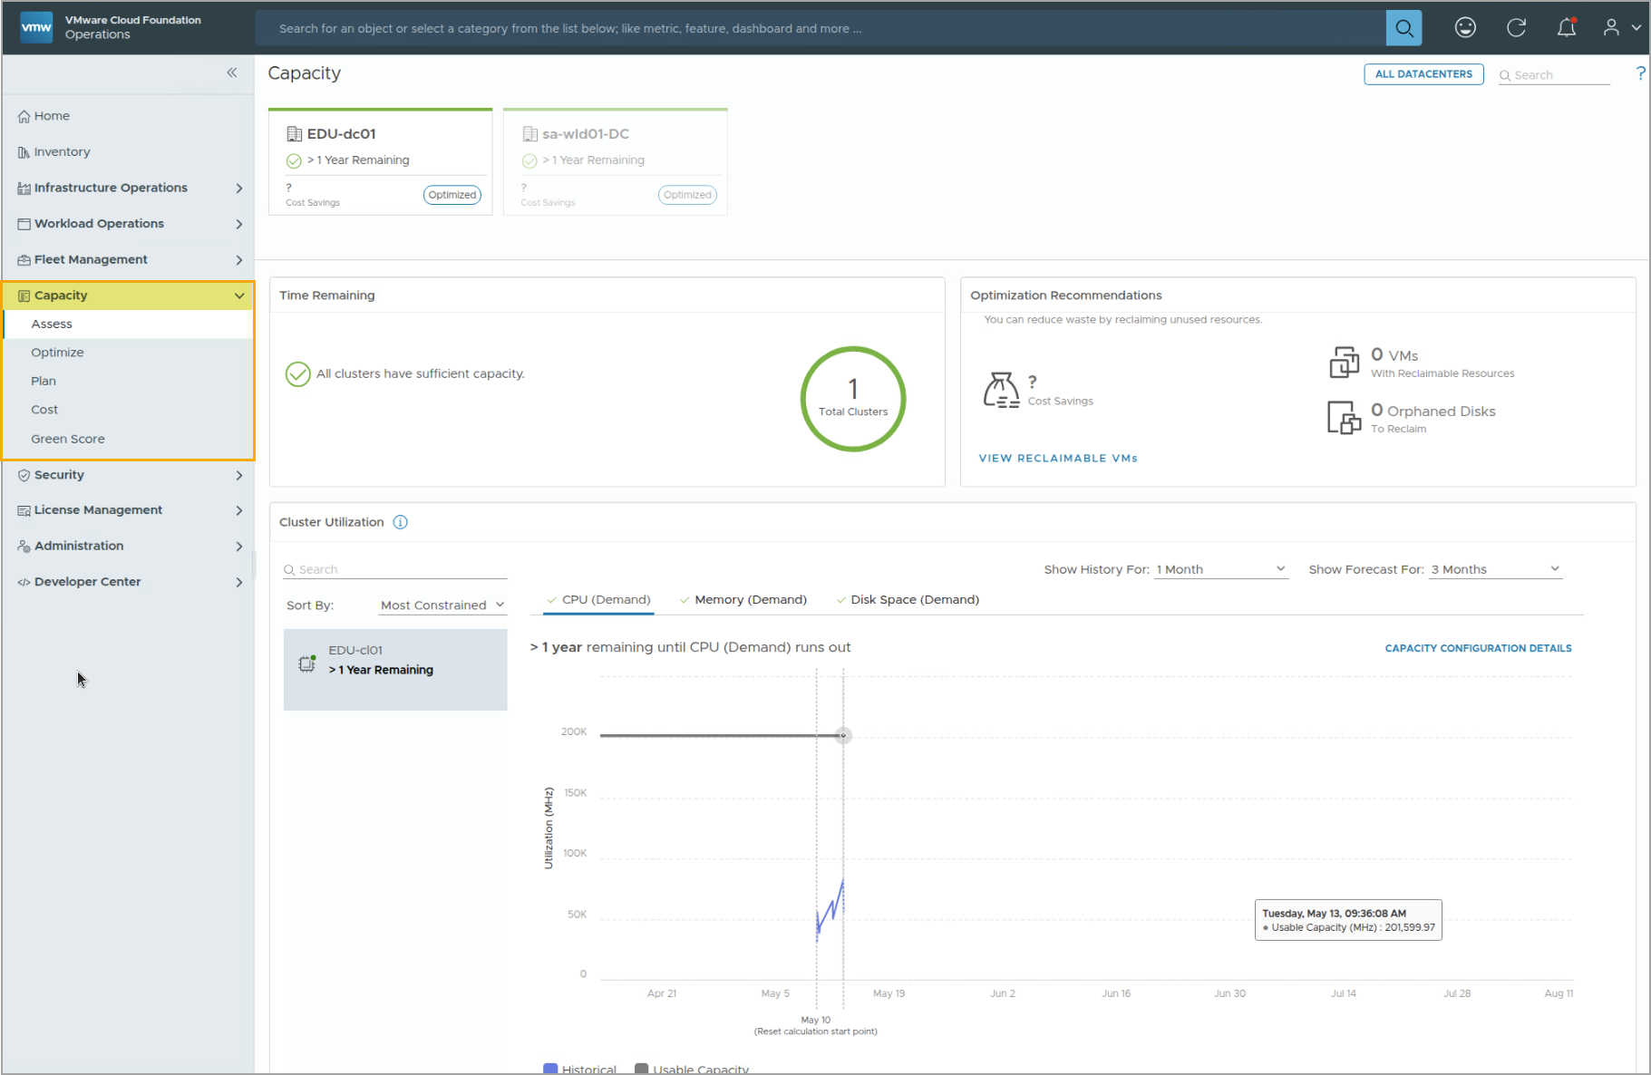
Capacity Page
The Capacity page allows you to monitor resource utilization, plan for growth, achieve cost efficiency, and maintain performance in a virtualized environment.
Notes:
TalkTrack:
The Capacity page enables monitoring resource utilization, planning for growth, achieving cost efficiency, and maintaining performance in a virtualized environment. The Capacity option allows for assessing data center capacity. It helps identify savings and automate reclamation. Capacity planning based on demand across clouds is supported. The system can predict demand and shortfalls, offering recommendations. Additionally, it allows for assessing the costs associated with running the data center.
<End>
The Capacity option enables you to perform the following activities:
Assess the capacity of the data center.
Identify savings and automate reclamation.
Plan capacity based on the demand across clouds.
Predict demand and shortfalls and get recommendations.
Assess the costs of running the data center.

Slide 45
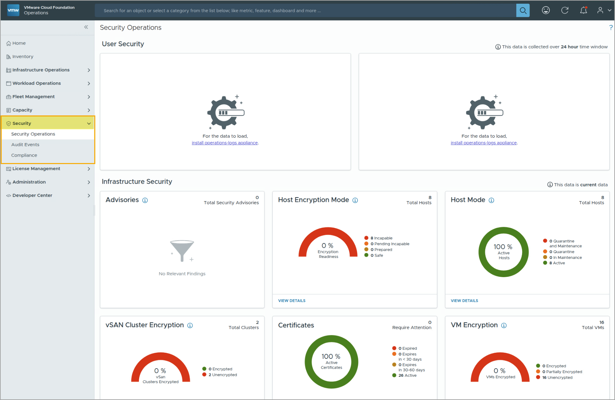
Security Page
The Security page allows you to gain insights into Security Operations and Audit Events.
You can also enable various VMware predefined benchmarks and regulatory benchmarks to enforce compliance monitoring.
Notes:
TalkTrack:
The Security page offers insights into Security Operations and Audit Events. Various VMware predefined benchmarks and regulatory benchmarks can be enabled to enforce compliance monitoring.
<End>

Slide 46
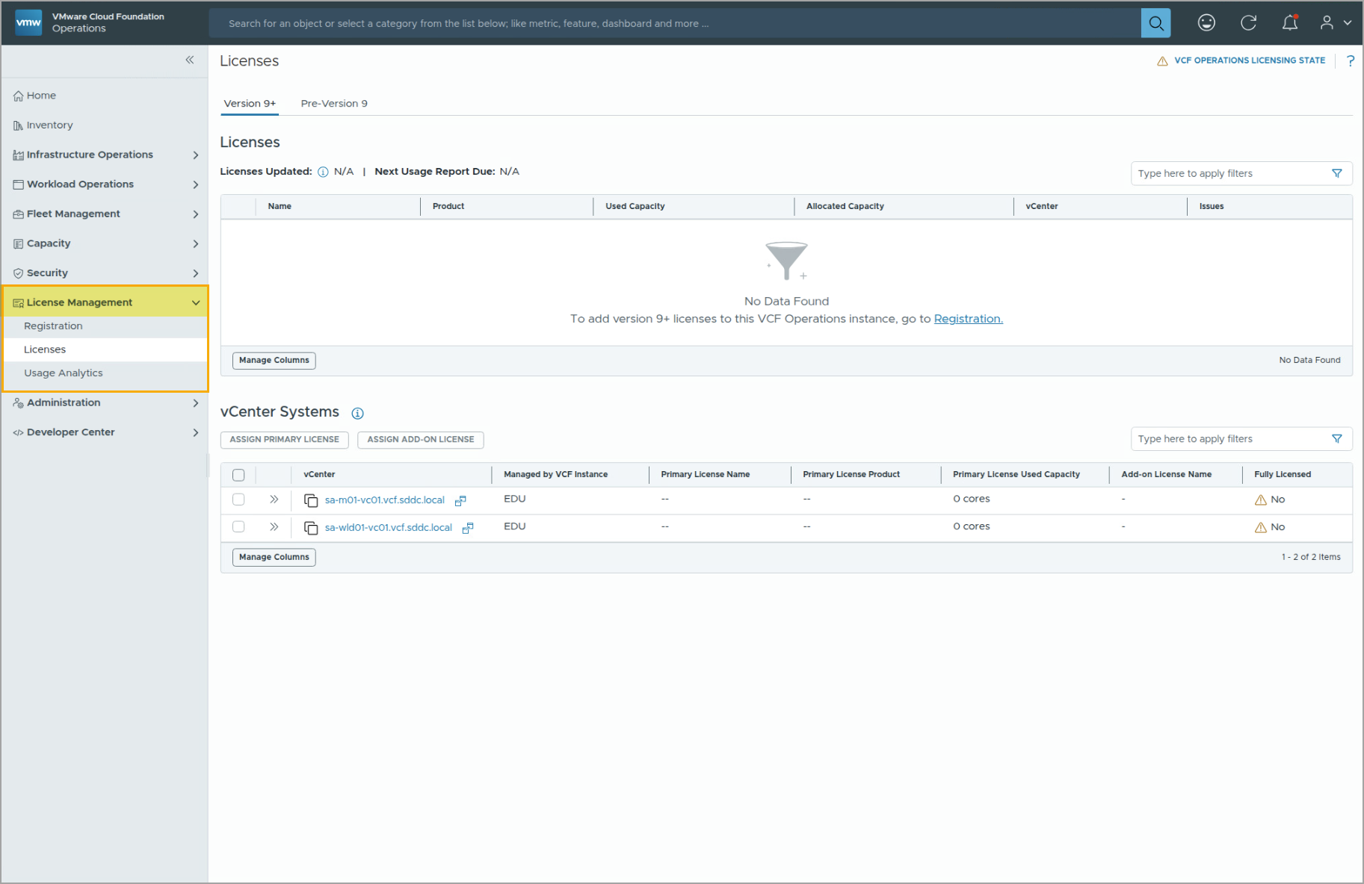
License Management
The License Management page allows you to manage the VCF product registrations and licenses for your organization, and monitor product and license usage.
Notes:
TalkTrack:
The License Management page allows for managing VCF product registrations and licenses for an organization. It also provides monitoring capabilities for product and license usage.
<End>

Slide 47
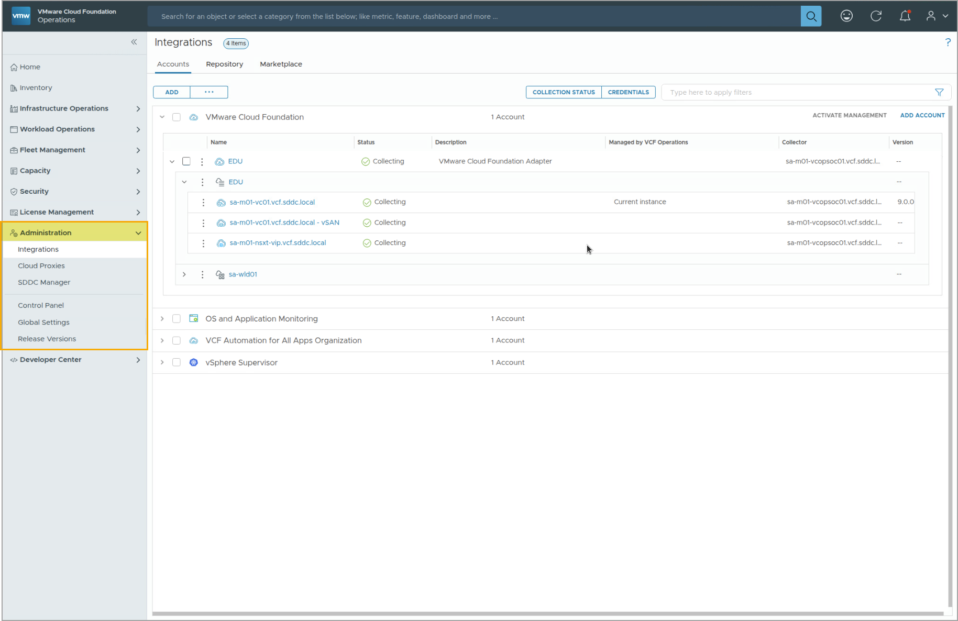
Administration Page
The Administration page allows you configure and manage integration accounts, cloud proxies, and collector groups.
You can configure Global Settings for your VCF Operations console, such as data retention history, cost/price unit, session timeout, and more.
Notes:
TalkTrack:
The Administration page facilitates the configuration and management of integration accounts, cloud proxies, and collector groups. Global settings for the VCF Operations console are configurable, including data retention history, cost or price units, and session timeout.
<End>

Slide 48
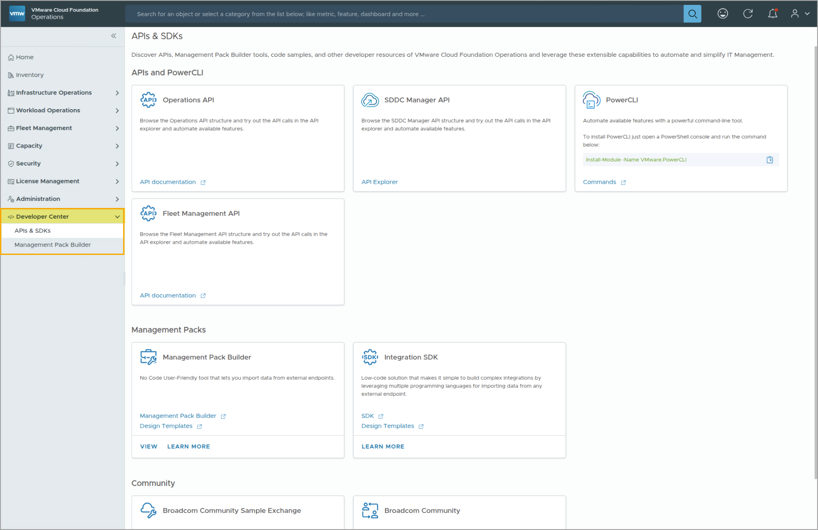
Developer Center
The Developer Center page allows you to access useful product APIs and CLI libraries to enable more ways of infrastructure operations and management.
You can also build custom management packs using Management Pack Builder, which is a no-code and user-friendly tool, to help you construct the data sources connectivity and API commands to achieve the desired outcomes.
Notes:
TalkTrack:
The Developer Center page provides access to useful product APIs and CLI libraries. This enables additional methods for infrastructure operations and management. Custom management packs can be constructed using Management Pack Builder. This is a no code, user friendly tool for building data source connectivity and API commands to achieve specific outcomes.
<End>

Slide 49
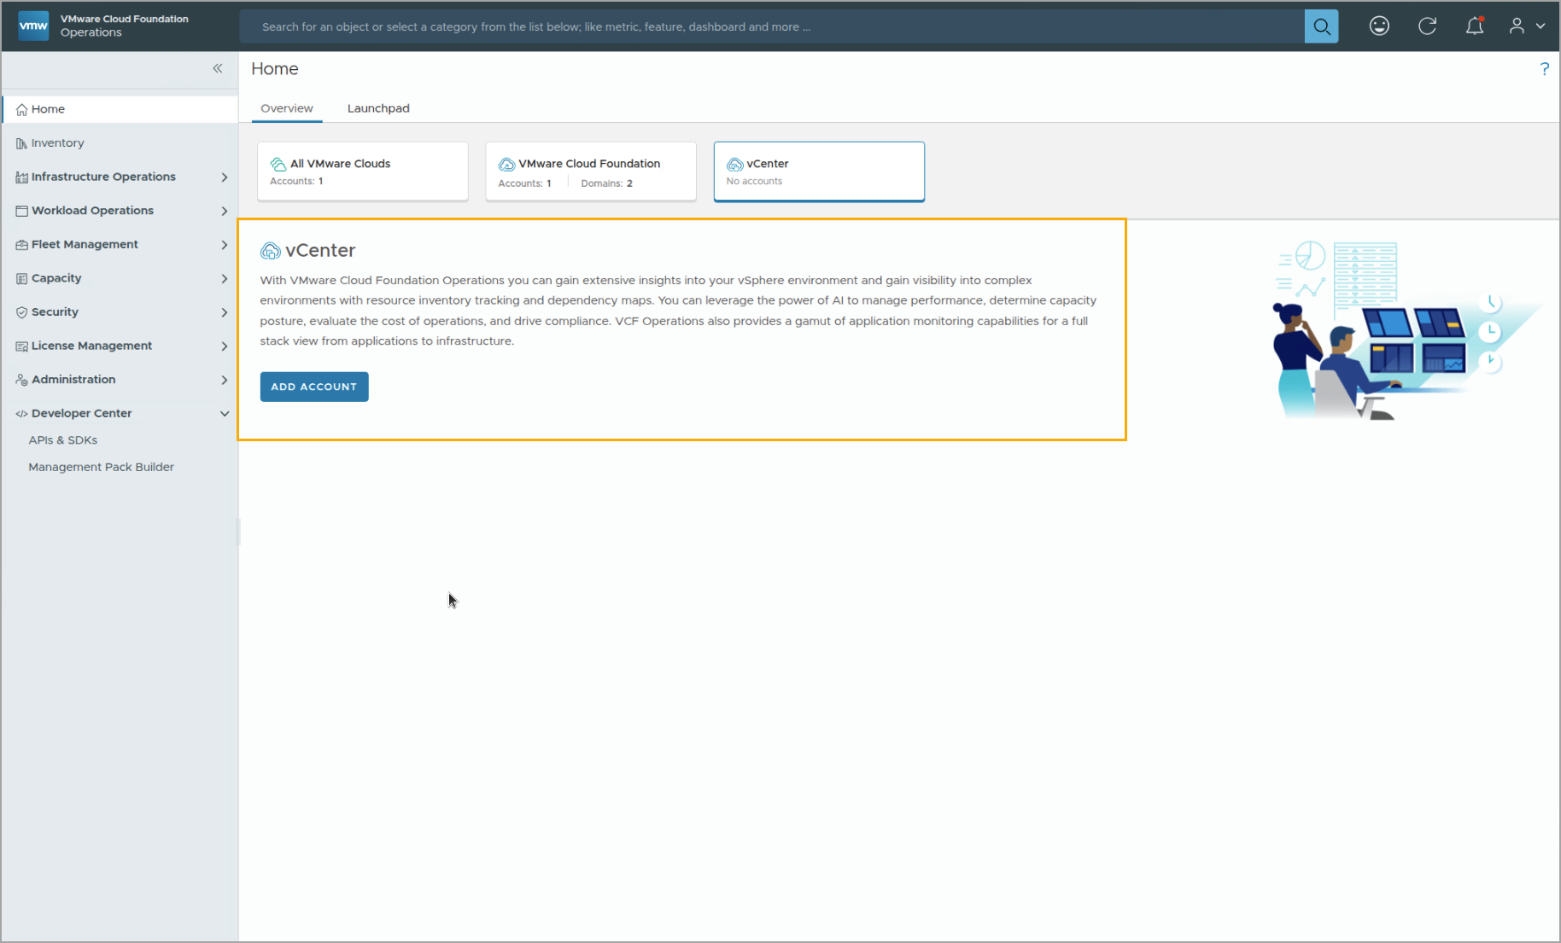
Example: Using the VCF Operations Console
You use VCF Operations to connect and analyze data from other VMware data sources, such as vCenter.
From your VCF Operations console Home page, click Overview, select vCenter, and click ADD ACCOUNT to configure your vCenter environment as a data source. After adding the vCenter account, your VCF Operations console begins to display data, such as inventory list, gathered from your vCenter environment.
You can also add more accounts through Administration > Integrations on the left side of the VCF Operations navigation menu.
Notes:
TalkTrack:
VCF Operations connects to and analyzes data from other VMware data sources, such as vCenter. From the VCF Operations console Home page, navigate to Overview, select vCenter, and click ADD ACCOUNT to configure the vCenter environment as a data source. Once the vCenter account is added, the VCF Operations console will display data, including an inventory list, gathered from the vCenter environment. Additional accounts can be added through Administration > Integrations on the left side of the VCF Operations navigation menu.
<End>

Slide 50
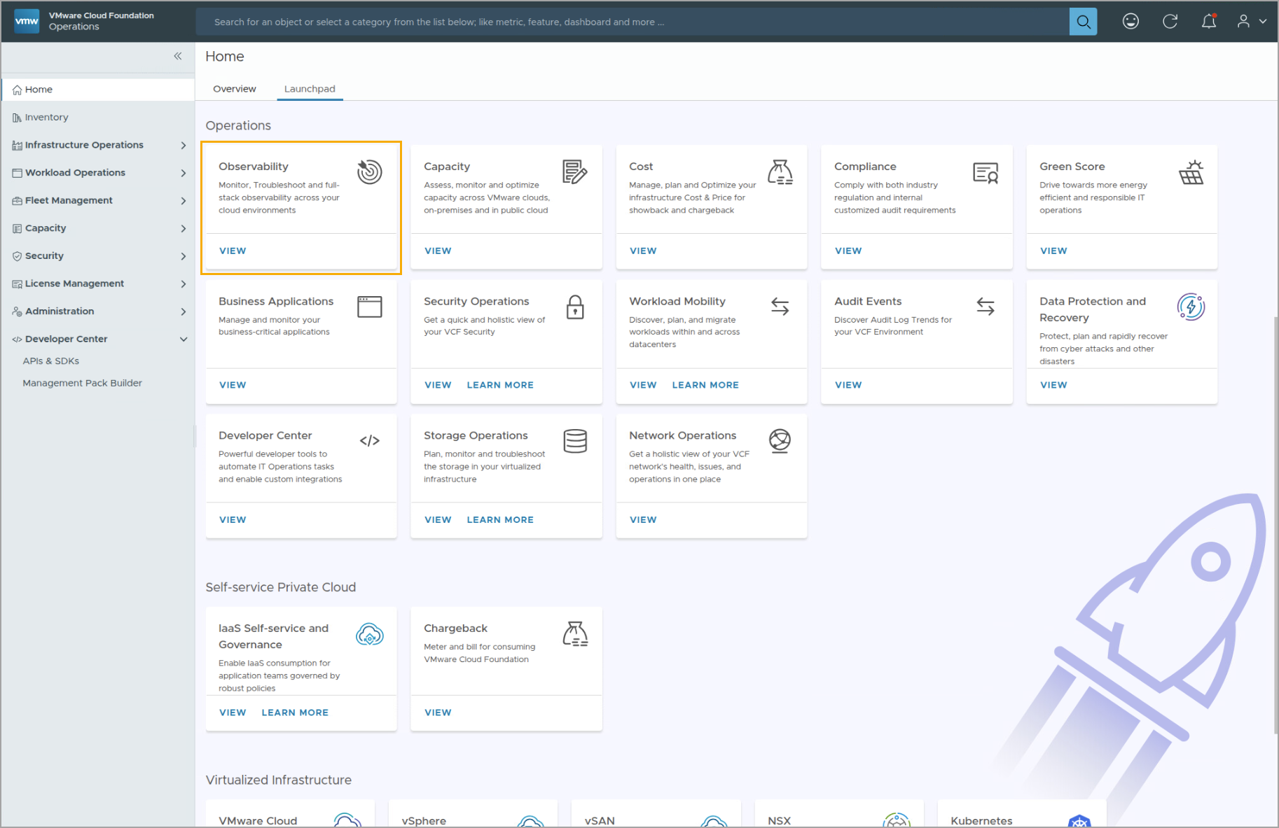
Example: Using the Observability Function Pillar
The Observability function pillar provides quick access to the monitoring and troubleshooting options available in VCF Operations. You can click Observability on the Launchpad tab to access the observability functions.
You can also access the same options through the Infrastructure Operations on the left side of the VCF Operations navigation menu.
Notes:
TalkTrack:
The Observability function pillar offers quick access to monitoring and troubleshooting options within VCF Operations. These functions can be accessed by clicking Observability under the Launchpad tab. The same options are also available through the Infrastructure Operations section on the left side of the VCF Operations navigation menu.
<End>

Slide 51
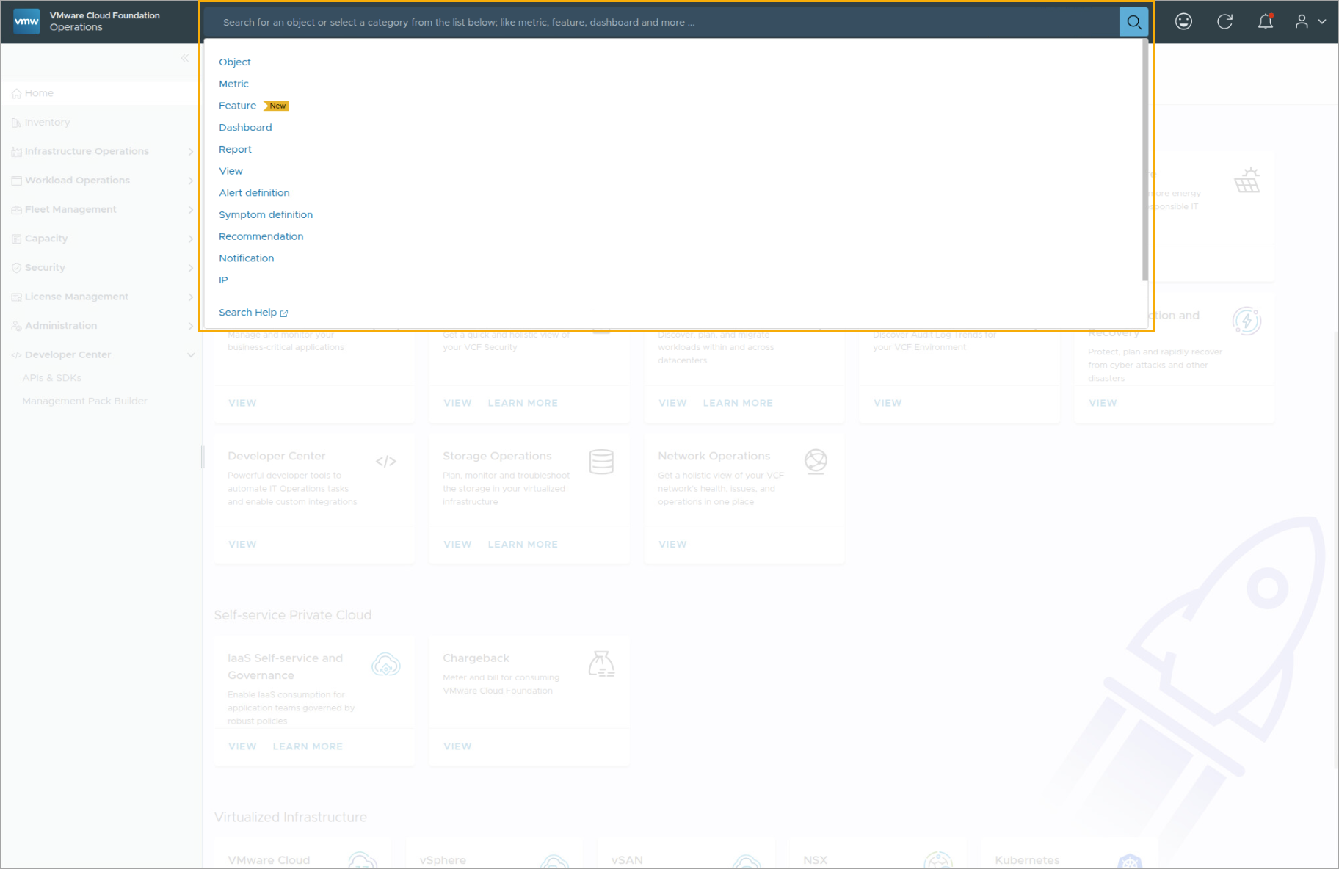
Understanding the Search Function
With the Search function, you can enter one of the listed categories and then search for objects in the category.
Notes:
TalkTrack:
The search function, located at the top of the VCF Operations console, is a powerful tool designed to quickly locate specific objects or information within your environment. Instead of navigating through multiple menus, users can directly input a query. The system supports searching across various categories, including objects like virtual machines or hosts, performance metrics, specific features, dashboards, and reports. This capability significantly enhances the operational efficiency by providing a streamlined way to pinpoint relevant data for troubleshooting, monitoring, or reporting purposes. For instance, if you need to find a particular VM's details, or a specific performance metric, you can leverage this search bar to quickly pull up the relevant information without extensive manual Browse.
<End>

Slide 52
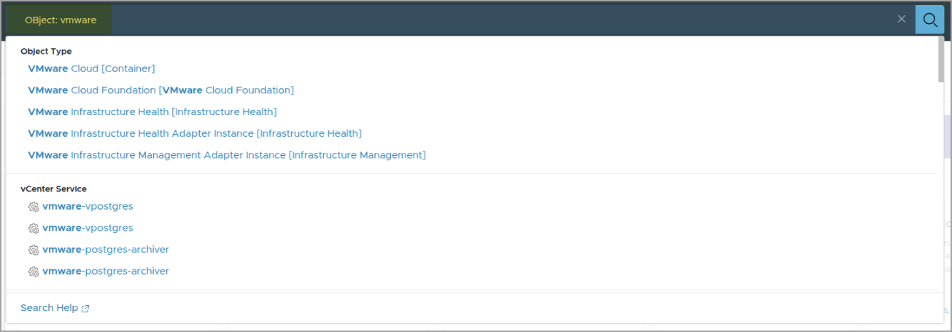
Example: Using the Search Function
In this example, the user searches for an object with vmware in its name.
From the returned list of suggestions, you can click directly on one of the links.
Clicking the link opens the object's summary page.
Notes:
TalkTrack:
Following our discussion on the general capabilities of the search function, this slide provides a practical example of its use. Here, a user initiates a search by typing "vmware" into the search bar. As the term is entered, the system dynamically generates a list of suggestions, categorizing them by object type, such as VMware Cloud or vCenter Service. This real-time suggestion feature helps users quickly narrow down their search. From this list, a user can directly click on any of the suggested links. This action will immediately navigate them to the summary page for that specific object, providing a quick way to access detailed information without additional clicks or navigation steps. This demonstrates how the search function streamlines the process of finding and accessing specific elements within the VCF Operations console.
<End>

Slide 53
Lab: Navigating VCF Operations UI
Access your lab environment and review a deployed VCF Operations instance:
Log In to the VCF Operations Administration UI
Navigate Pages in the VCF Operations Product UI
Use the Search Functionality to Find Objects
Use Dashboards and Topology to Navigate the Environment

Slide 54
Review of Learner Objectives
Perform basic VCF Operations console navigation
List the different management areas in the VCF Operations UI

